Slide 1



Making better conservation decisions
Jeffrey Hanson
jeffrey.hanson@uqconnect.edu.au
jeffrey-hanson.com

Slide 2



Acknowledgements
Allison Binley
Brandon Edwards
Dobrochna Delsen
Dan Wismer
Hugh Possingham
James Allan
Joseph Bennett
Martin Jung
Marc Edwards
Matthew Strimas-Mackey
Nina Morell
Peter Arcese
Piero Visconti
Richard Schuster
Virgilio Hermoso

Slide 3
Now
Biodiversity
Status quo
2000
Future

Slide 4
Now
How do we
get here?
Biodiversity
Status quo
2000
Future

Slide 5
How can we get a better conservation decision?
(1) Better algorithms
(2) Better data

Slide 6



Ecological surveys
Distribution maps
Priority areas
Biodiversity
2000
Future
Data
Information
Plan
Outcome
Objectives
Constraints

Slide 7
Ecological surveys
Distribution maps
Priority areas
Biodiversity
2000
Future
Data
Information
Plan
Outcome
Better
algorithms
Better
outcome
Objectives
Constraints

Slide 8





Heuristic
algorithm
Meta-heuristic
algorithms
Exact
algorithms
Estimate of best quality
Quality
Different
solutions
Different
solutions
Different
solutions

Slide 9

prioritizr: Systematic conservation prioritization in R
it’s an R package (yes, this is good)
flexible interface to customize problems
compatible with tabular and GIS data formats
supports planning for multiple zones/actions
powered by exact algorithm solvers

Slide 10
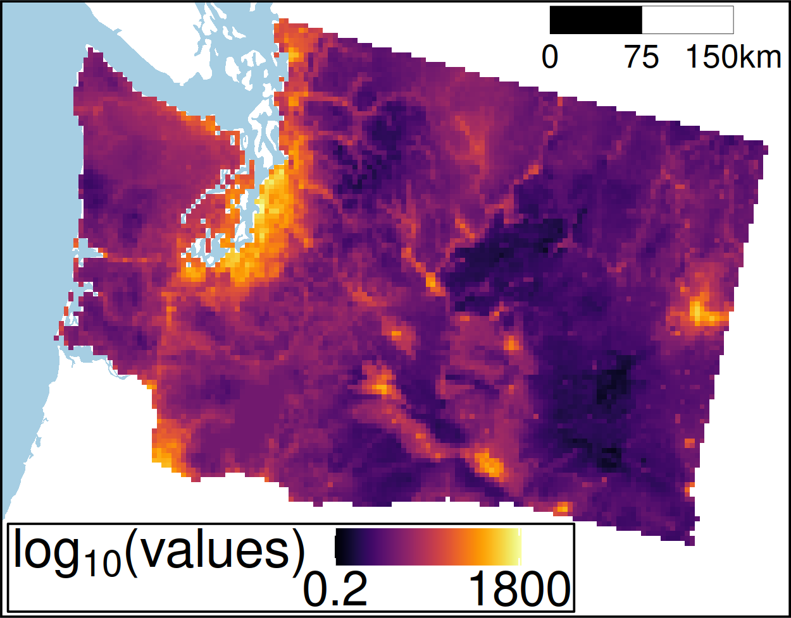
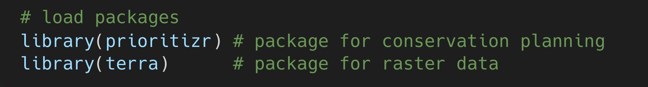
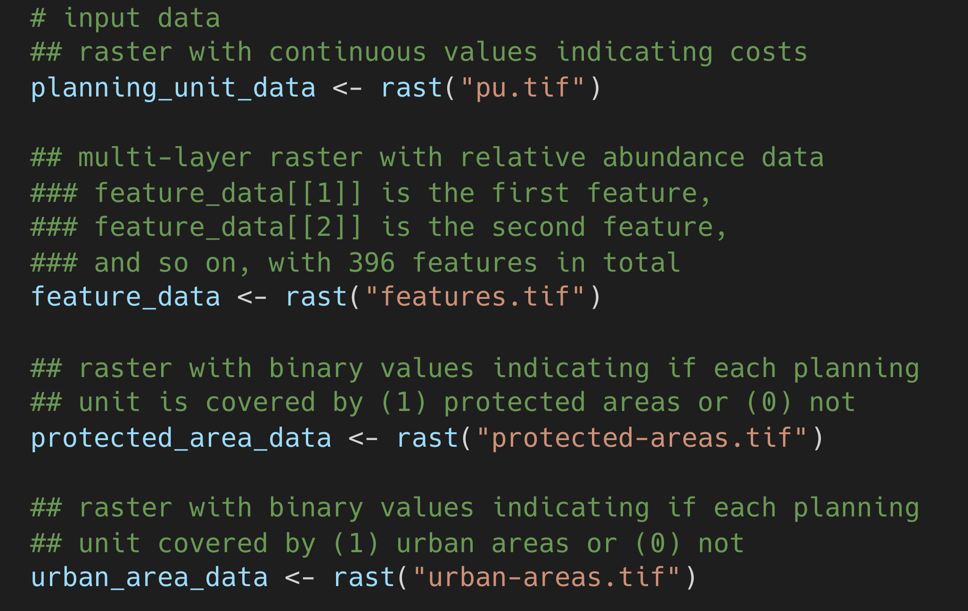
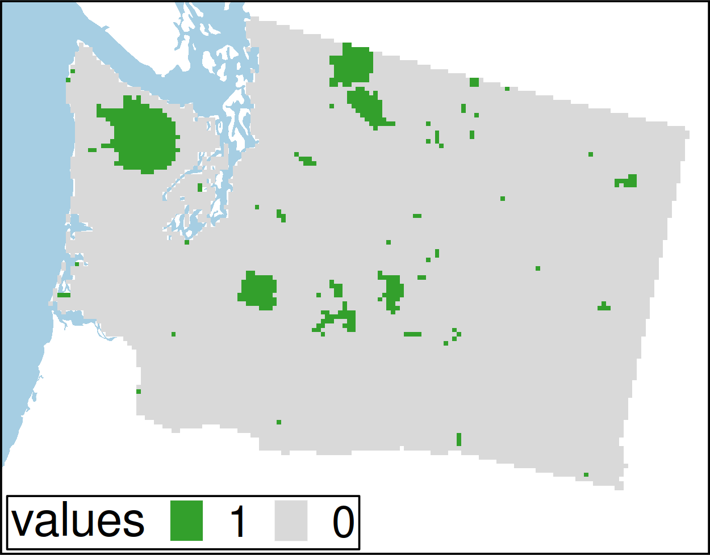
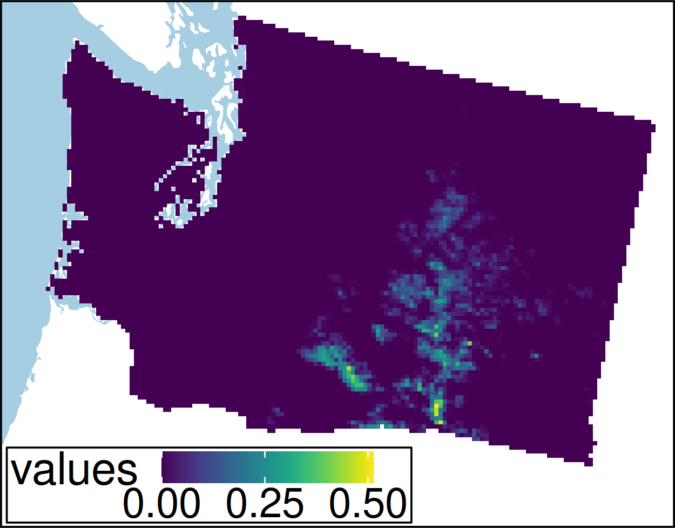
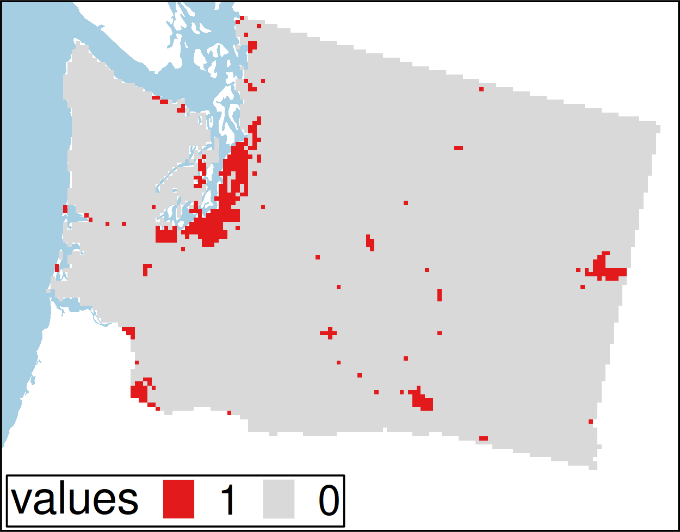
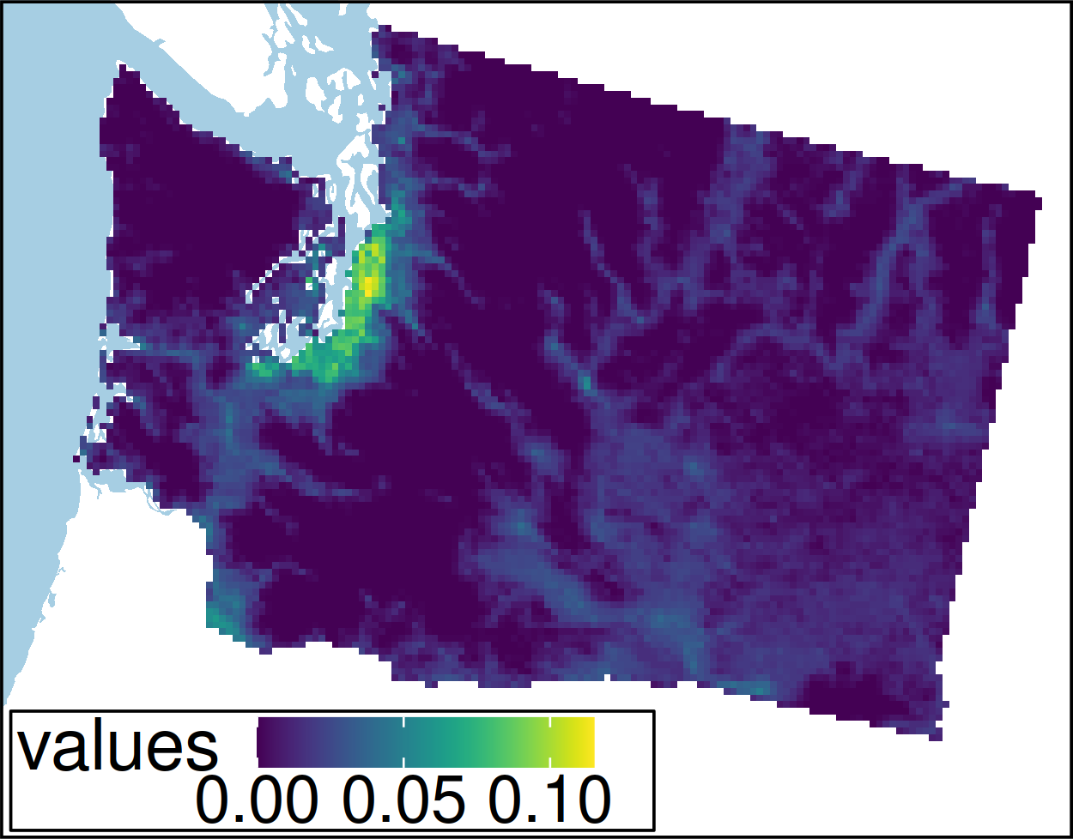
Worked example
??? et al. under review

Slide 11
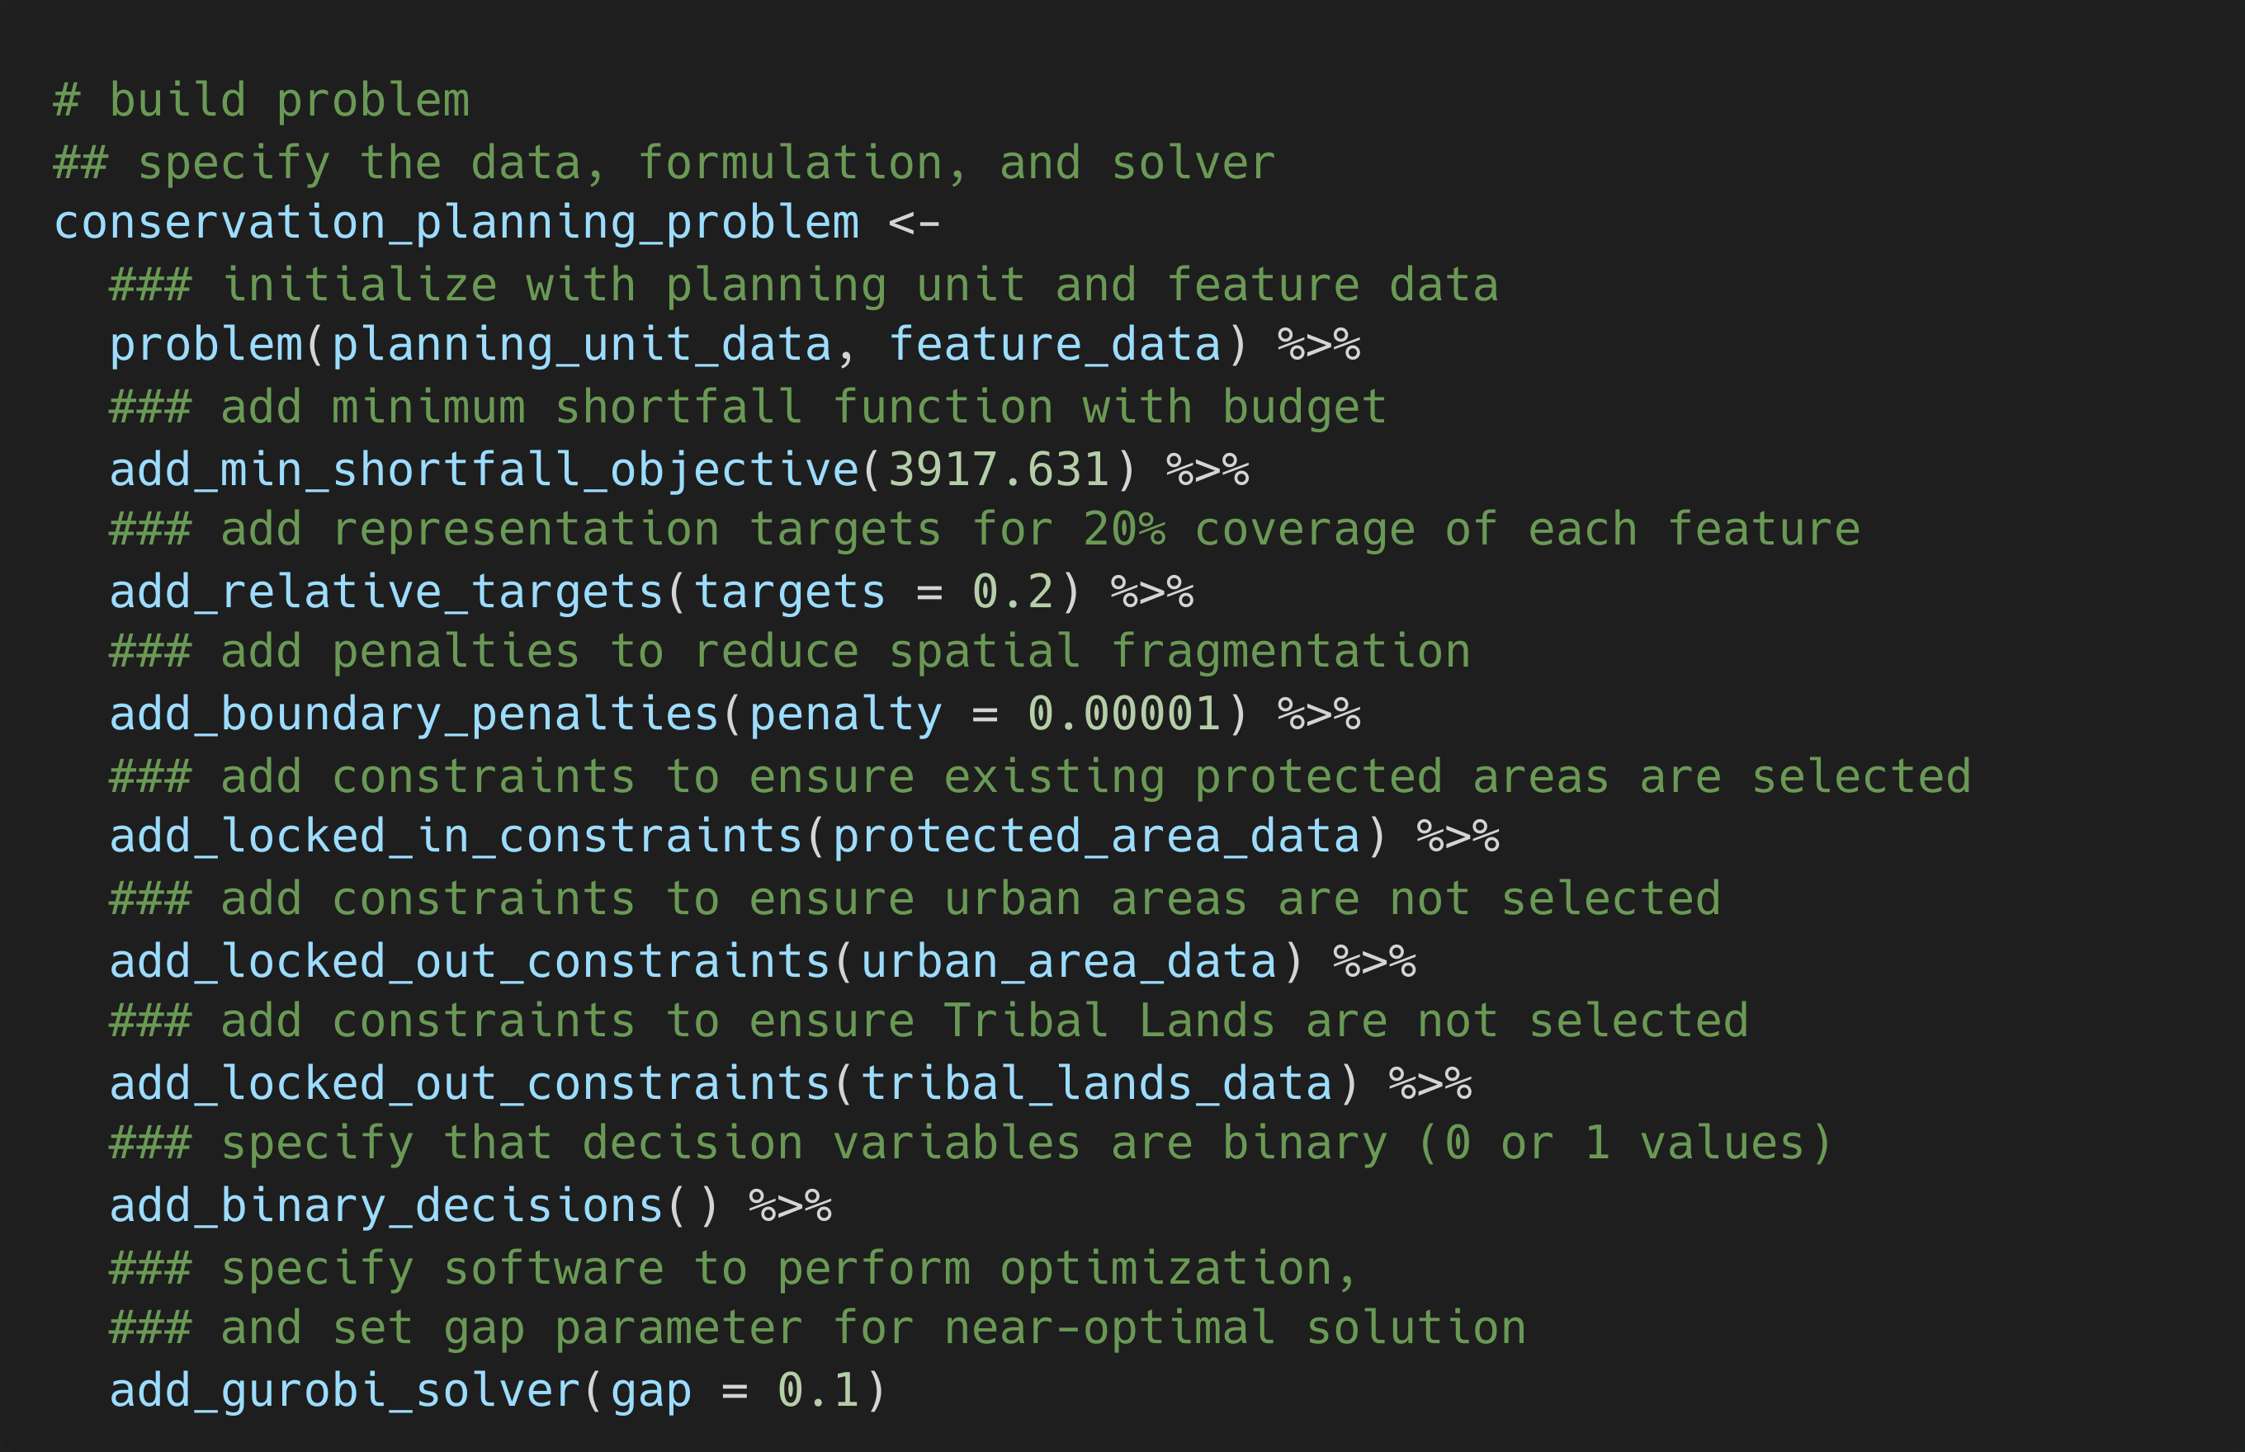
??? et al. under review

Slide 12
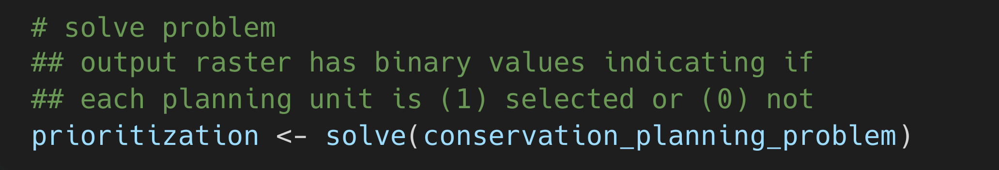
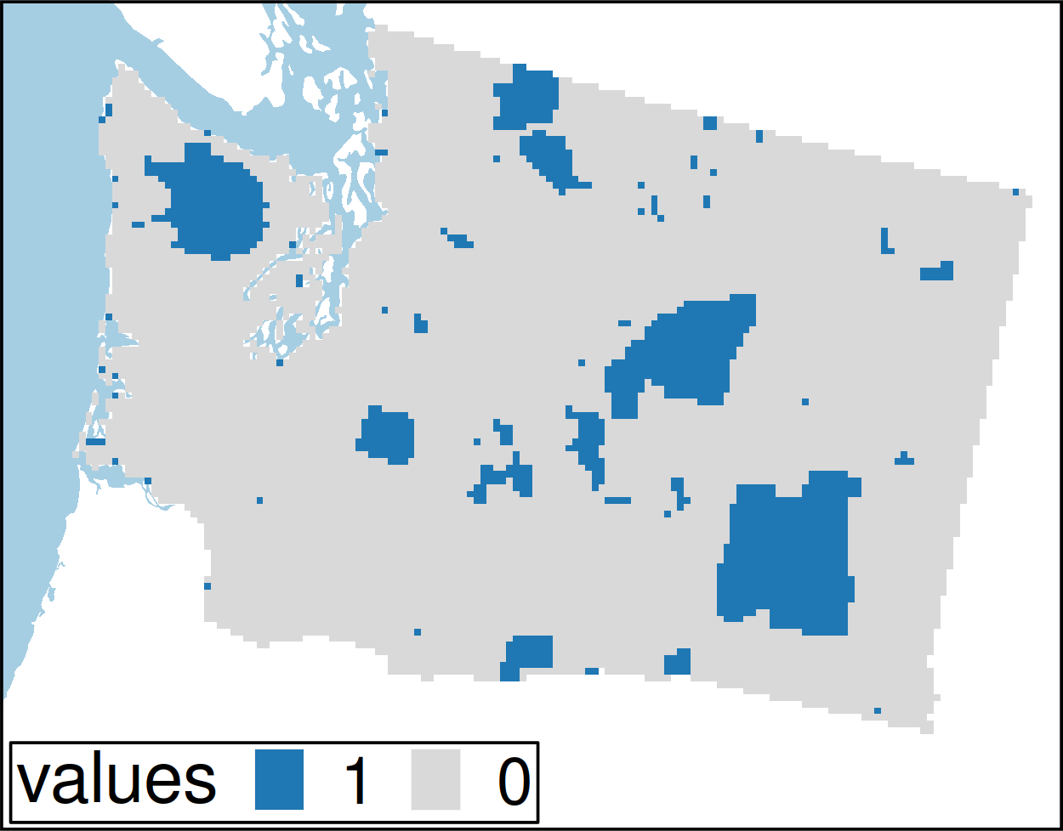
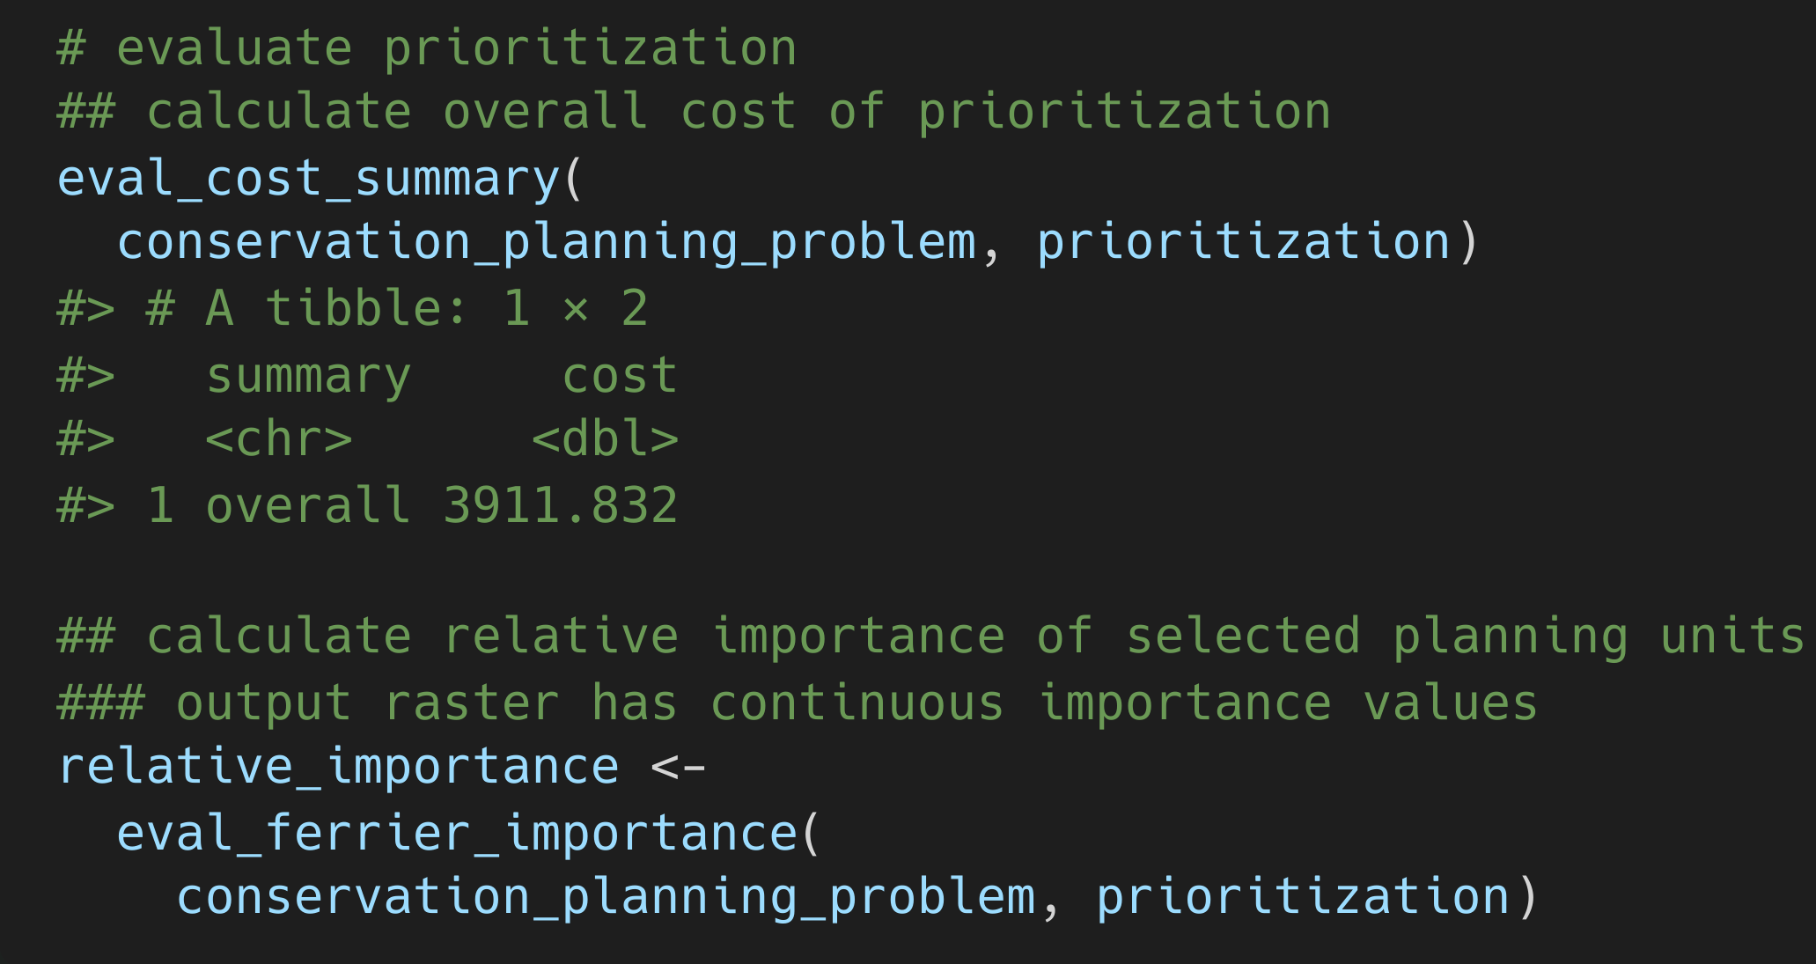
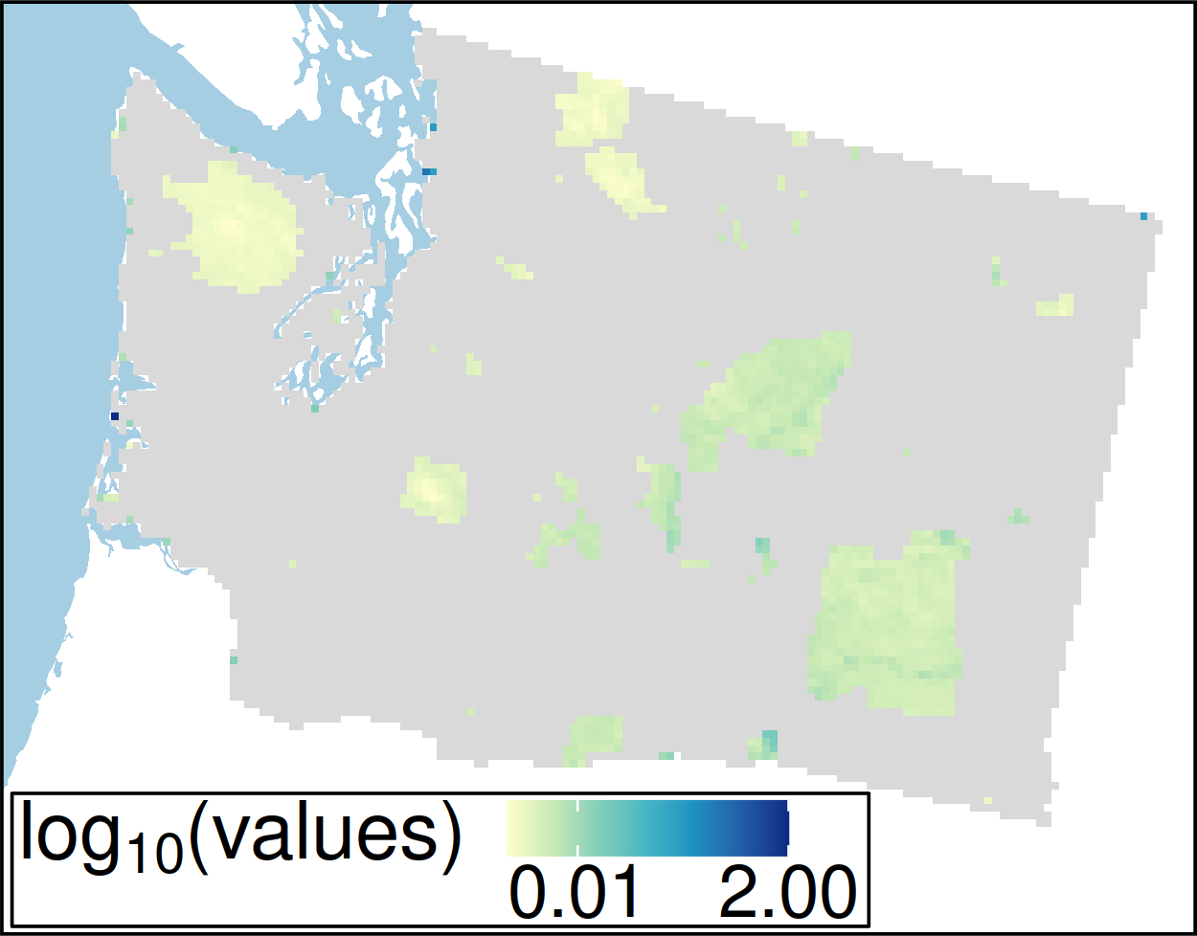
??? et al. under review

Slide 13
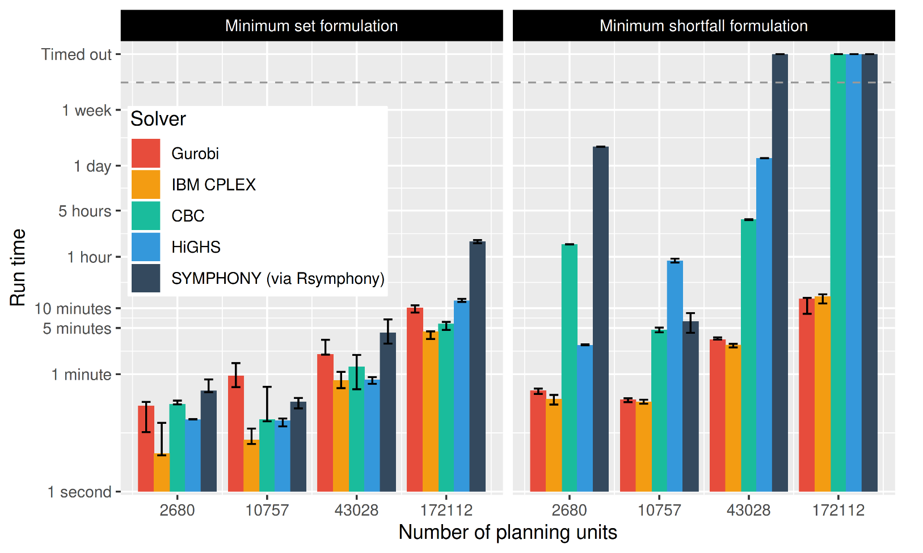
Solve problems pretty quickly!
Notes: 396 features, no planning units locked in or out, prioritizations ≤ 10% from optimality
??? et al. under review

Slide 14
Where to work
https://ncc.carleton.ca

Slide 15
How can we get a better conservation decision?
(1) Better algorithms
(2) Better data

Slide 16

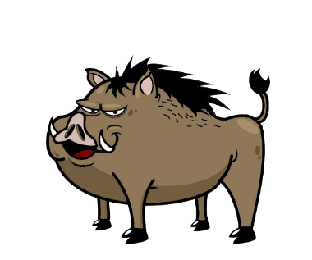




Conventional conservation planning
1. Area with biodiversity and
area impacted by threat
2. Establish protected area to
safeguard biodiversity
3. Positive conservation outcome?

Slide 17


Conservation is actions in places
1. Area with biodiversity and
area impacted by threat
2. Establish protected areas and
actions to manage threat
3. Positive conservation outcome

Slide 18




Which threats to abate?

Slide 19





Which threats to abate?

Slide 20
Which threats to abate?
$1M
$4M
$2M
$5M

Slide 21
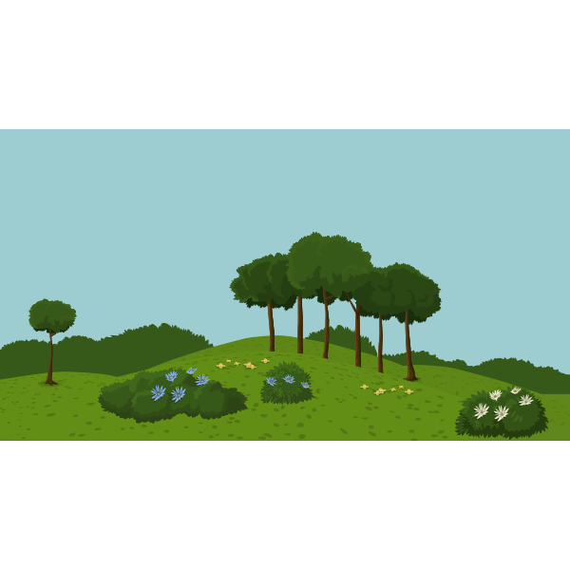

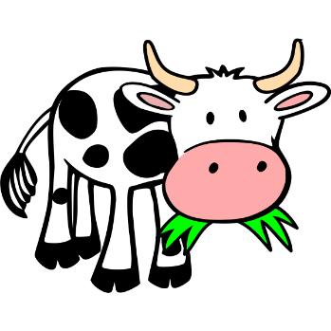
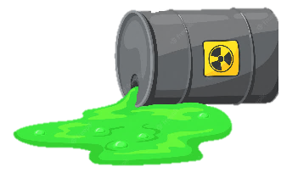


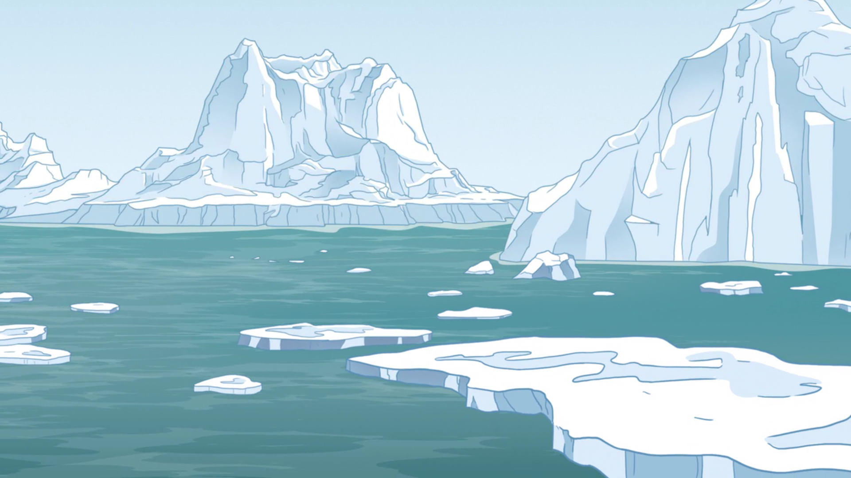


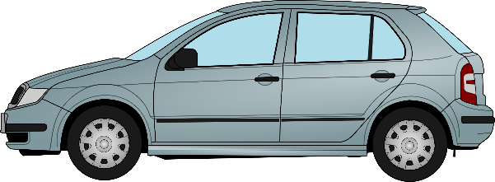

Which places to abate which threats?

Slide 22

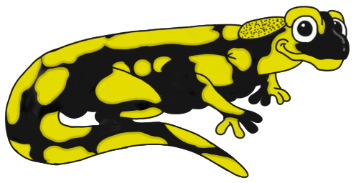
Provide each species with an adequate amount of threat-free habitat

Slide 23
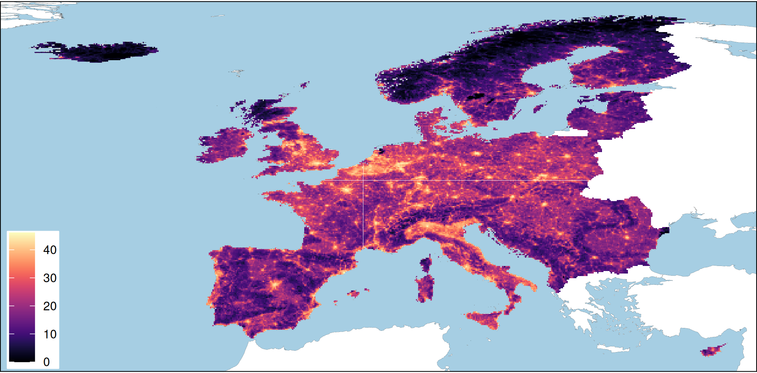
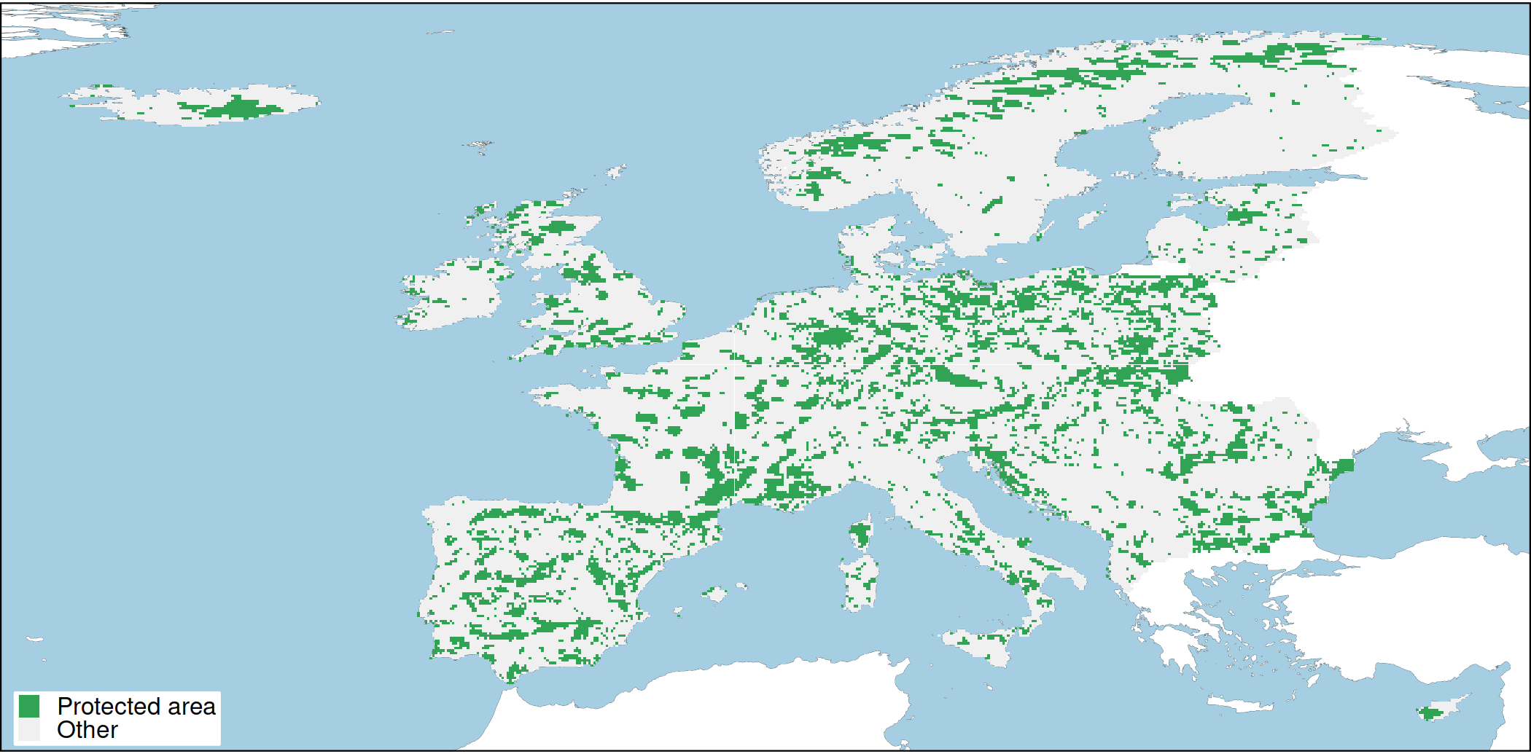
European case study
Majority of terrestrial vertebrate species
81 amphibian species
386 bird species
151 mammal species
98 reptile species
43 countries
10 × 10 km resolution planning units
Conservation benefit for a species = amount of threat-free habitat in conservation areas
Human pressure
Protected areas
Hanson et al. In prep

Slide 24
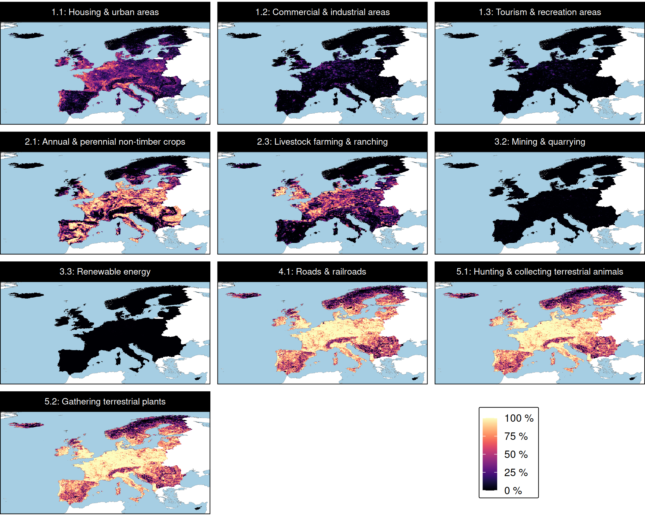
Threats
P
P
P = Permanent
R = Restoration
Management costs modelled using human footprint index as surrogate for opportunity costs
R
R
R
P
Hanson et al. In prep

Slide 25

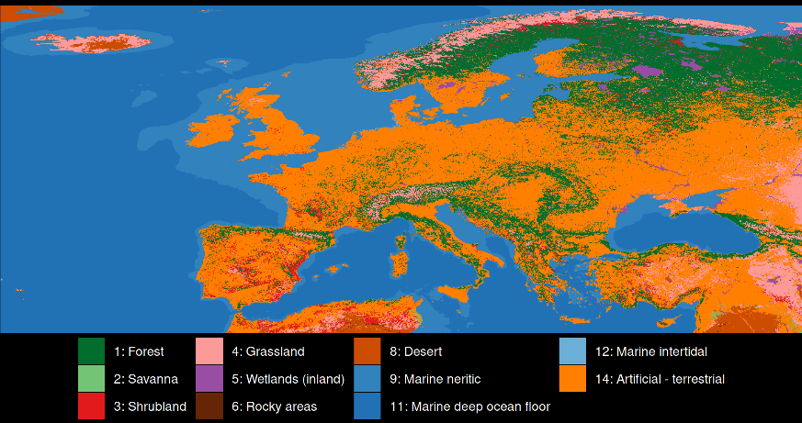
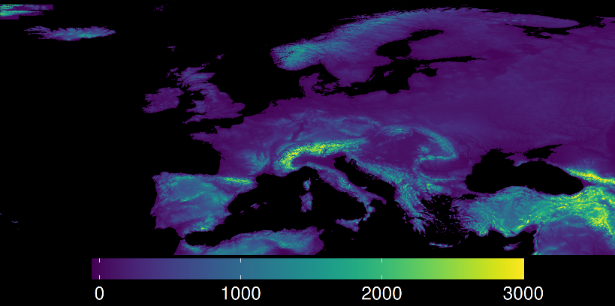
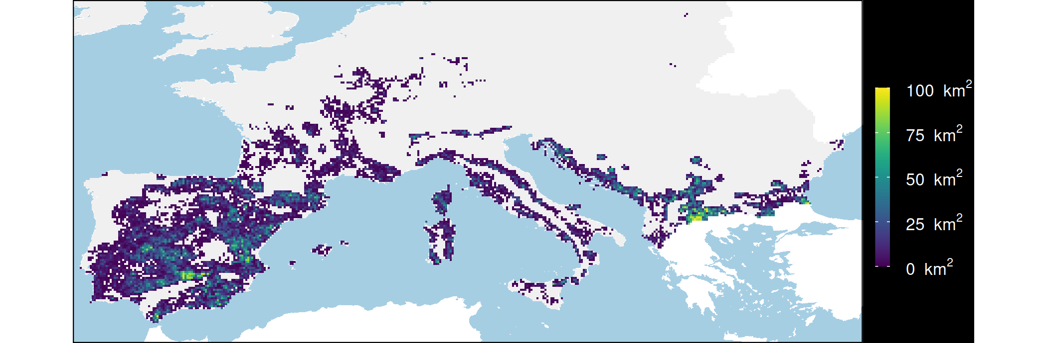
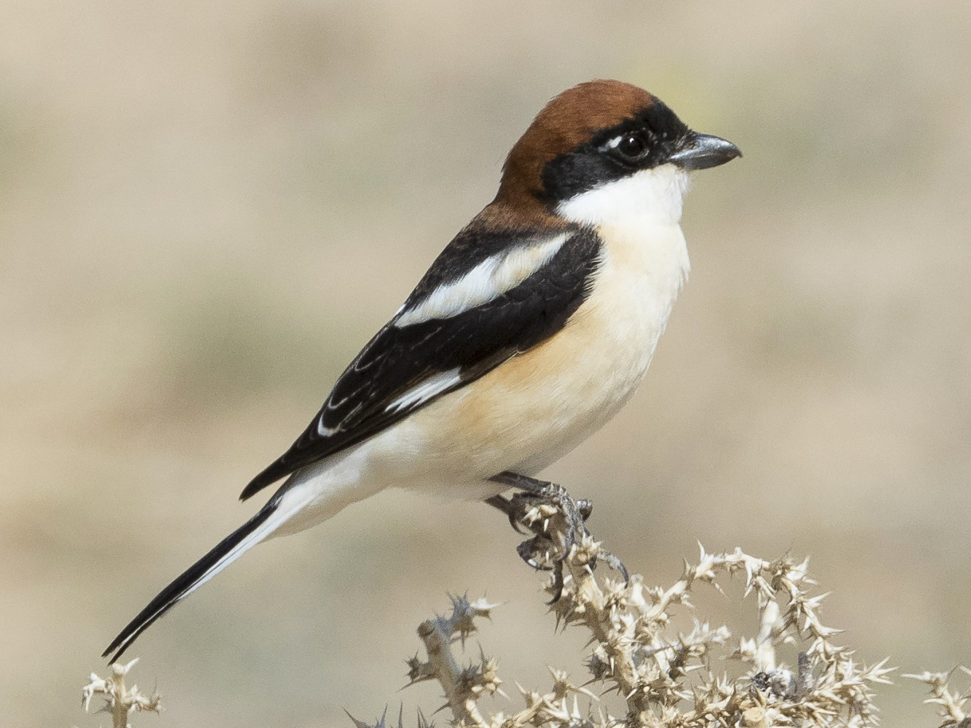
Mapping suitable habitat for species
Current land cover
Elevation
Threats
Species
habitat types
elevational limits
threat impacts
Woodchat Shrike
Area of threat-free habitat
Hanson et al. In prep

Slide 26



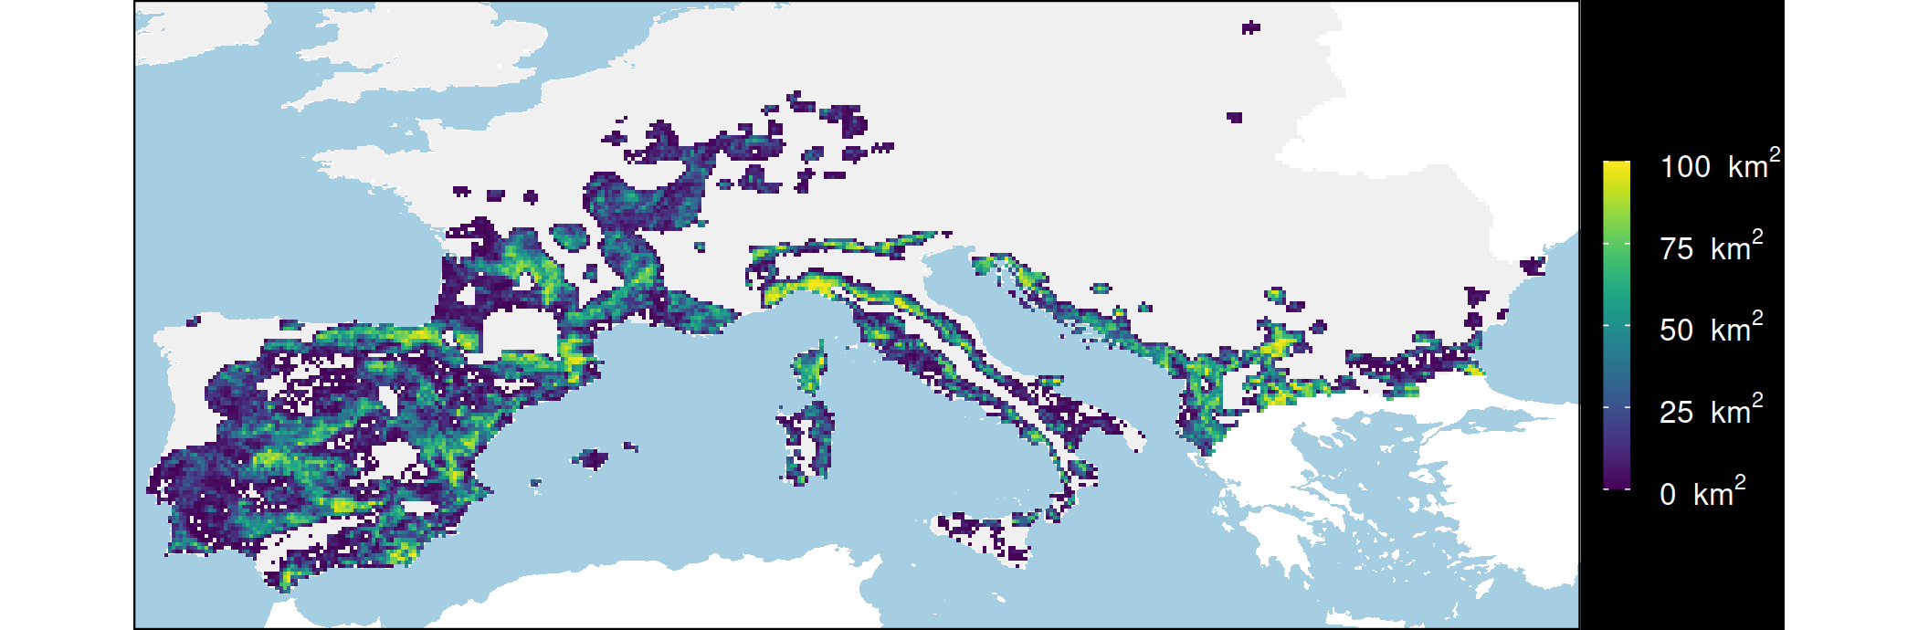
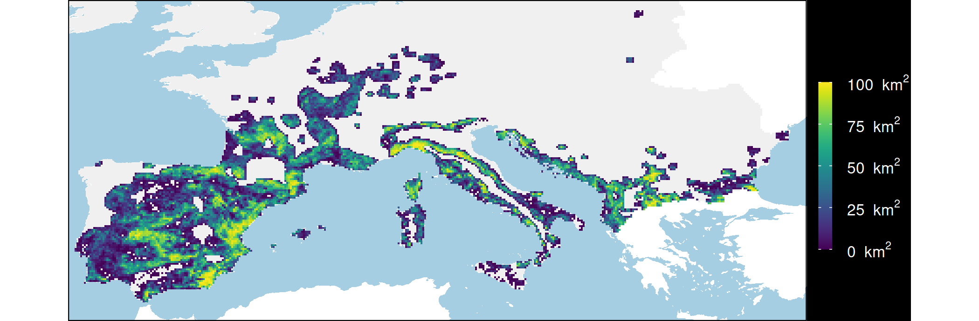

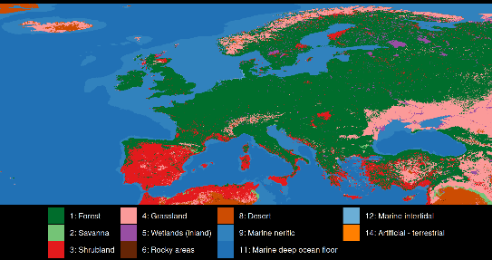
Mapping consequences of managing threats
Existing habitat
Species
Elevation
Woodchat Shrike
Restore croplands
Threats
What if?
Stop hunting
Current
land cover
Potential natural
vegetation
Restore croplands
& stop hunting
Hanson et al. In prep

Slide 27
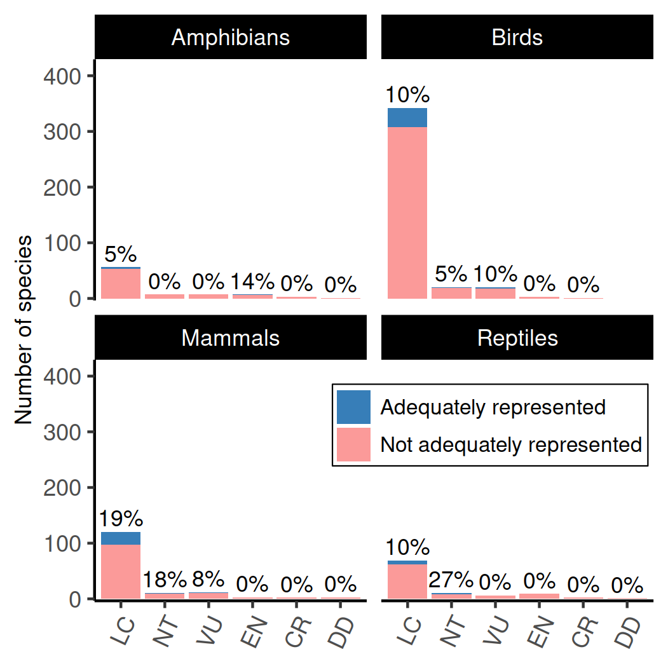
Existing protected areas
77 (11%) species adequately represented when accounting for threats
Only 4 of 61 critically endangered species adequately represented when accounting for threats
If we didn’t account for threats, then instead of 77 species, we would mistakenly think 137 species (19%) are adequately represented
Hanson et al. In prep

Slide 28
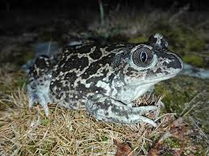
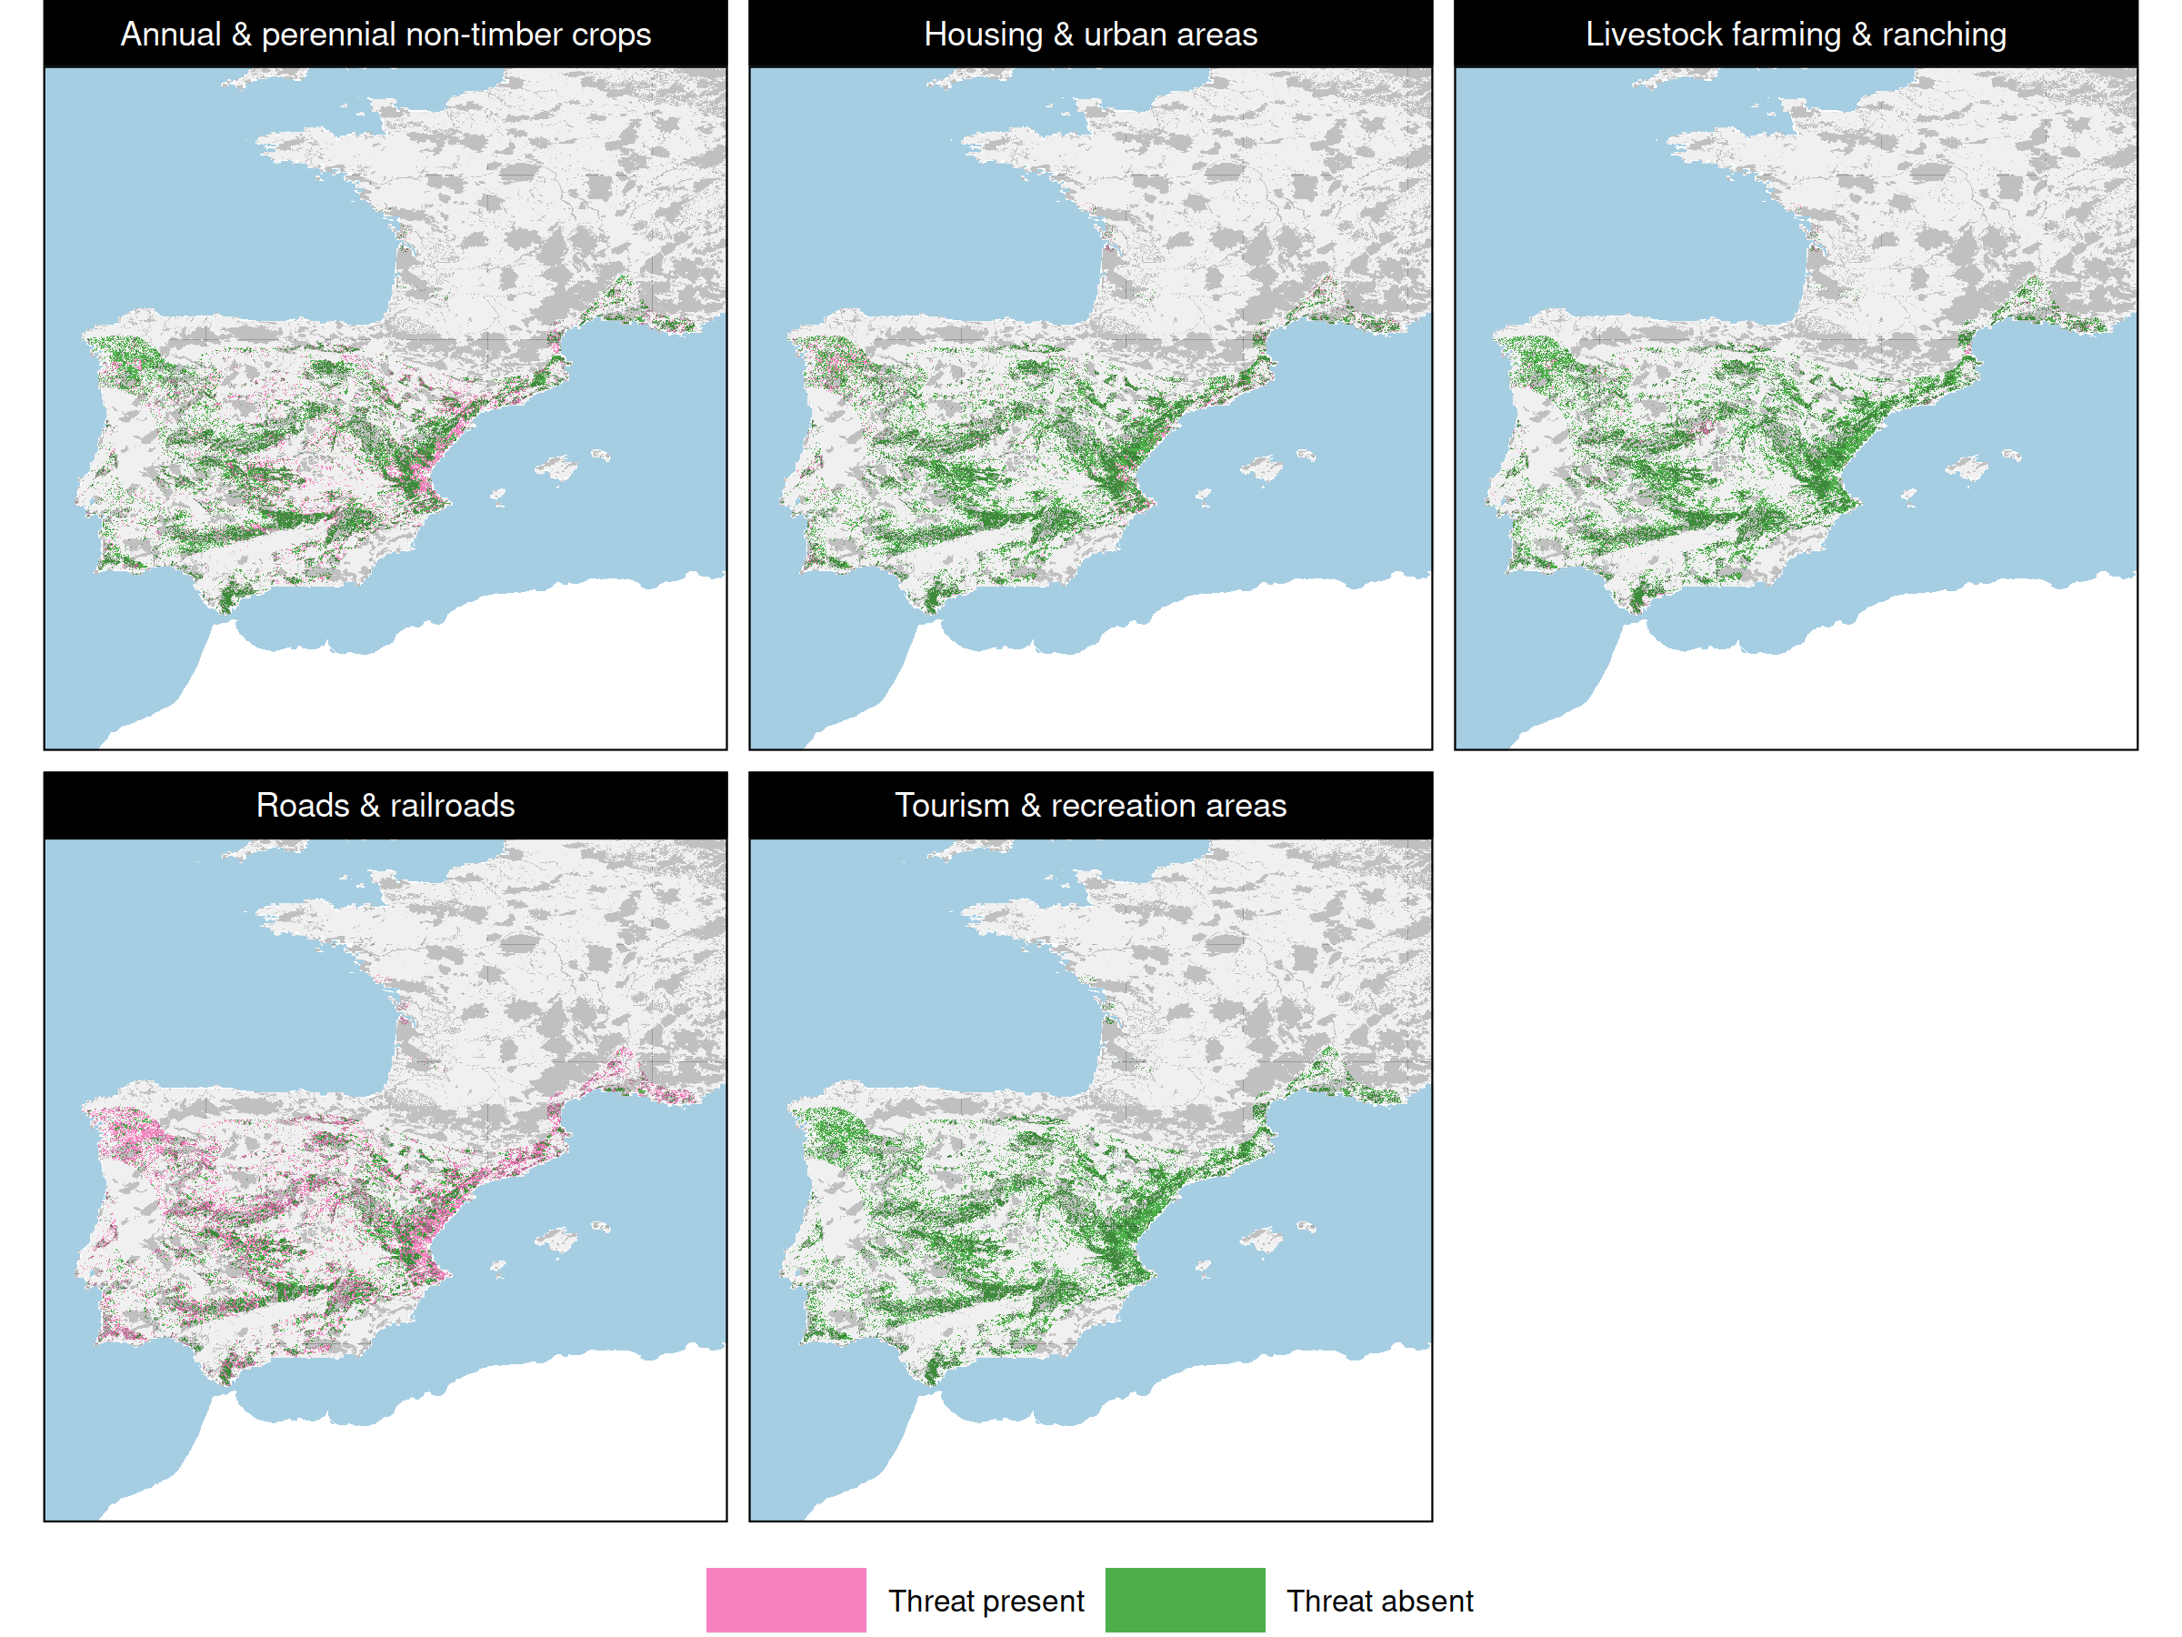

Pelobates cultripes
13% of current habitat covered by protected areas
10% representation target
Only 6% covered by protected areas that are free from threats that impact this species
Hanson et al. In prep

Slide 29
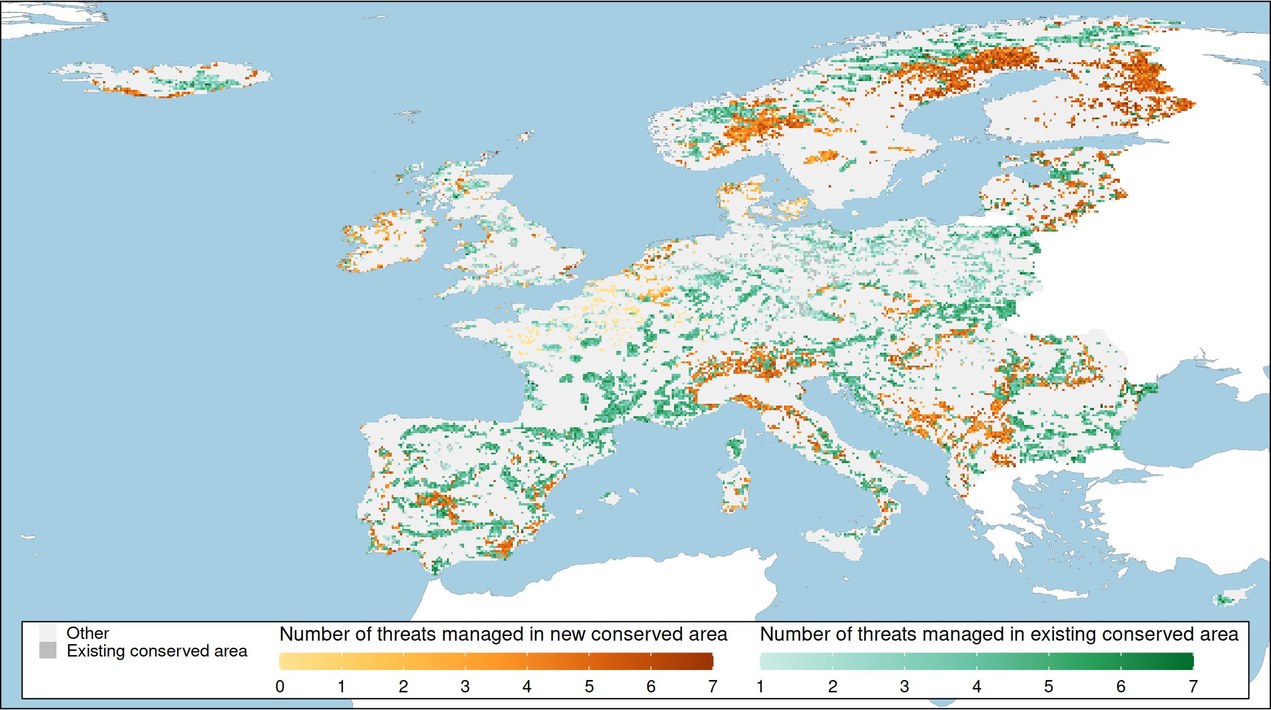
Prioritization to manage threats
Hanson et al. In prep

Slide 30
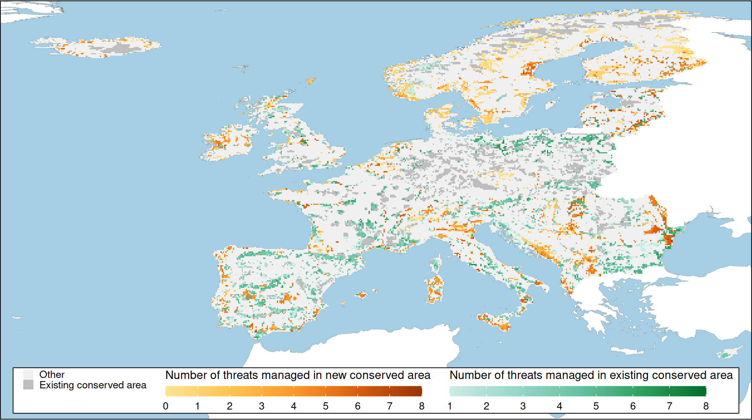
Prioritization to manage threats
Total system ≤ 30% of each country
Adequately represent 325 (45%) species
66% of priority areas managing inside existing conserved areas
32% of priority areas establishing new protected areas and managing threats
2% of priority areas simply protecting remnant habitat
Hanson et al. In prep

Slide 31
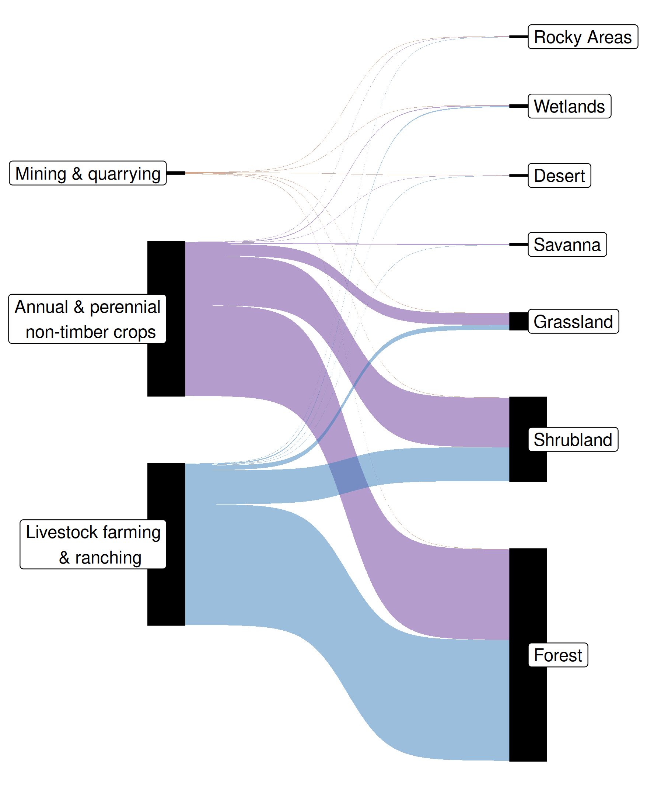
Habitat restoration
Of the 7 threats that could be managed, 3 associated with restoration actions
65% of priority areas involved restoring habitat inside protected areas
33% of priority areas involved restoring habitat in newly established protected areas
28% of Europe’s land prioritized for habitat restoration
EU pledged to restore 20%
Hanson et al. In prep

Slide 32
Make better conservation decisions by using…
1. Better algorithms
2. Cost-effective data

Slide 33




jeffrey.hanson@uqconnect.edu.au
github.com/jeffreyhanson
jeffrey-hanson.com

Slide 34
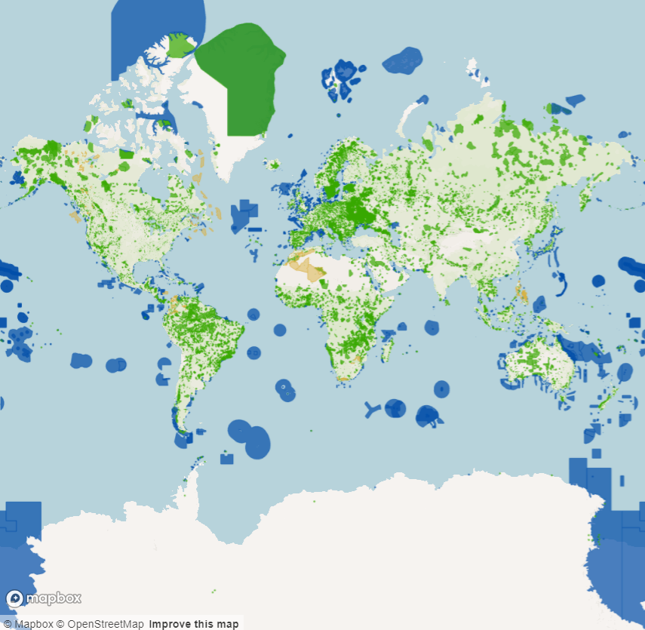
World database on Protected Areas (WDPA)
267 countries
268,721 terrestrial protected areas
18,638 marine protected areas
IUCN management categories

Slide 35
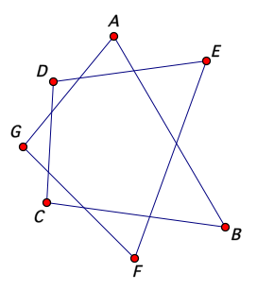
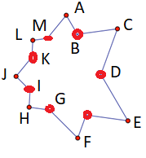
But data needs cleaning…
Self-intersections
Invalid geometries
Protected areas that aren’t implemented
Protected areas represented only as points
Protected areas that cross the dateline
Protected areas that don’t really do much
Removing slivers
Erase for overlapping areas

Slide 36
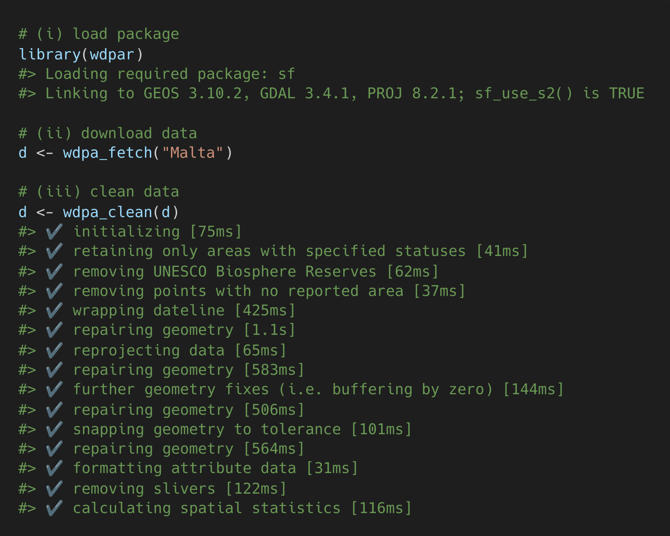
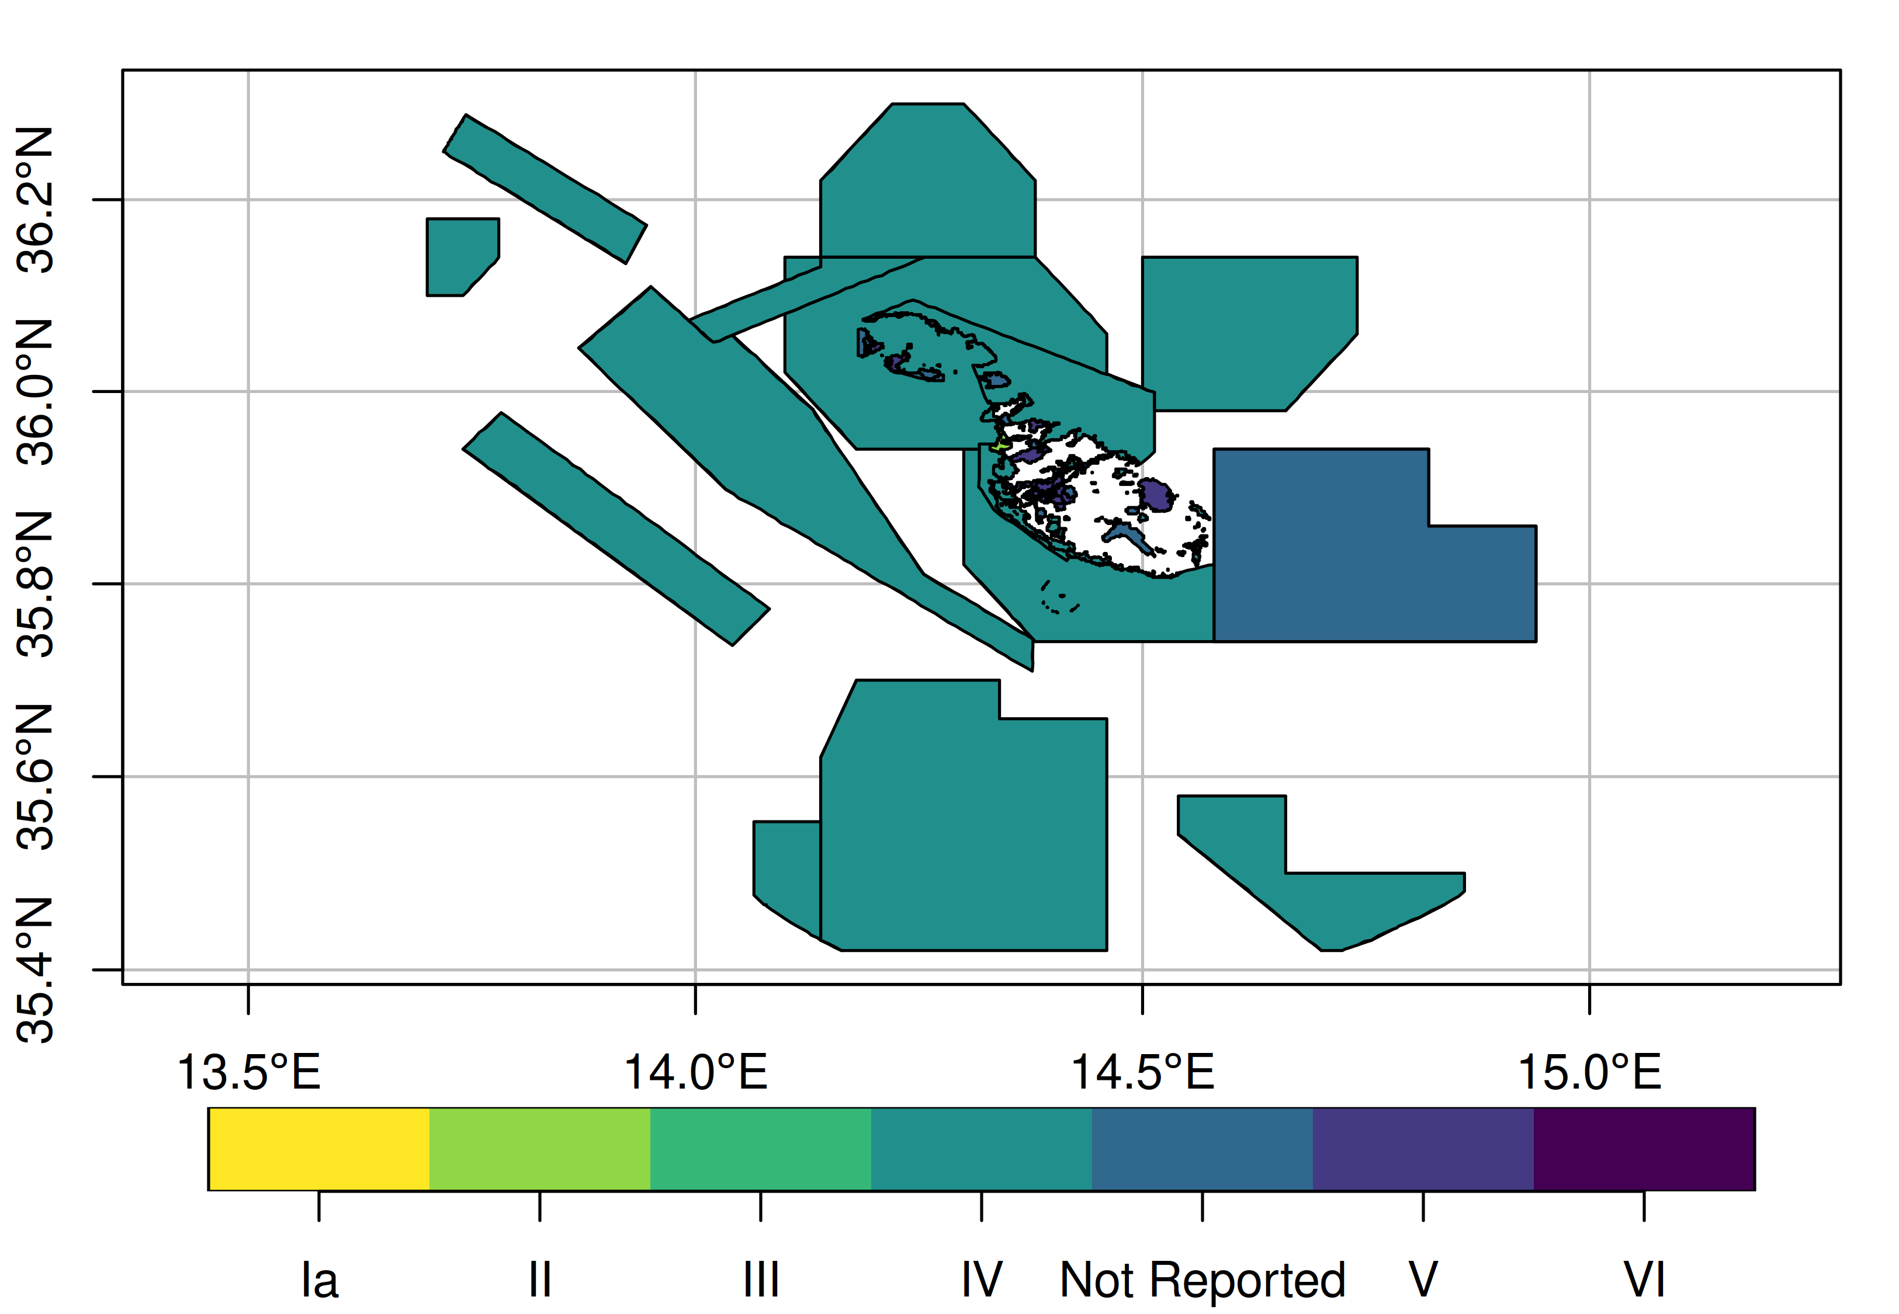
wdpar: Interface to the World Database on Protected Areas

Slide 37
Is more data
always better?

Slide 38
Ecological surveys
Distribution maps
Priority areas
Biodiversity
2000
Future
Data
Information
Plan
Outcome
Objectives
Constraints

Slide 39
Ecological surveys
Distribution maps
Priority areas
Biodiversity
?
?
?
?
?
?
2000
Future
Data
Information
Plan
Outcome
More
surveys
Better
models
Better
management
Better
outcome
Objectives
Constraints

Slide 40
Ecological surveys
Distribution maps
Priority areas
Biodiversity
?
?
?
?
?
?
?
?
?
?
?
?
2000
Future
Data
Information
Plan
Outcome
More
surveys
Better
models
Poorer
management
Worse
outcome
Objectives
Constraints
Less funding

Slide 41
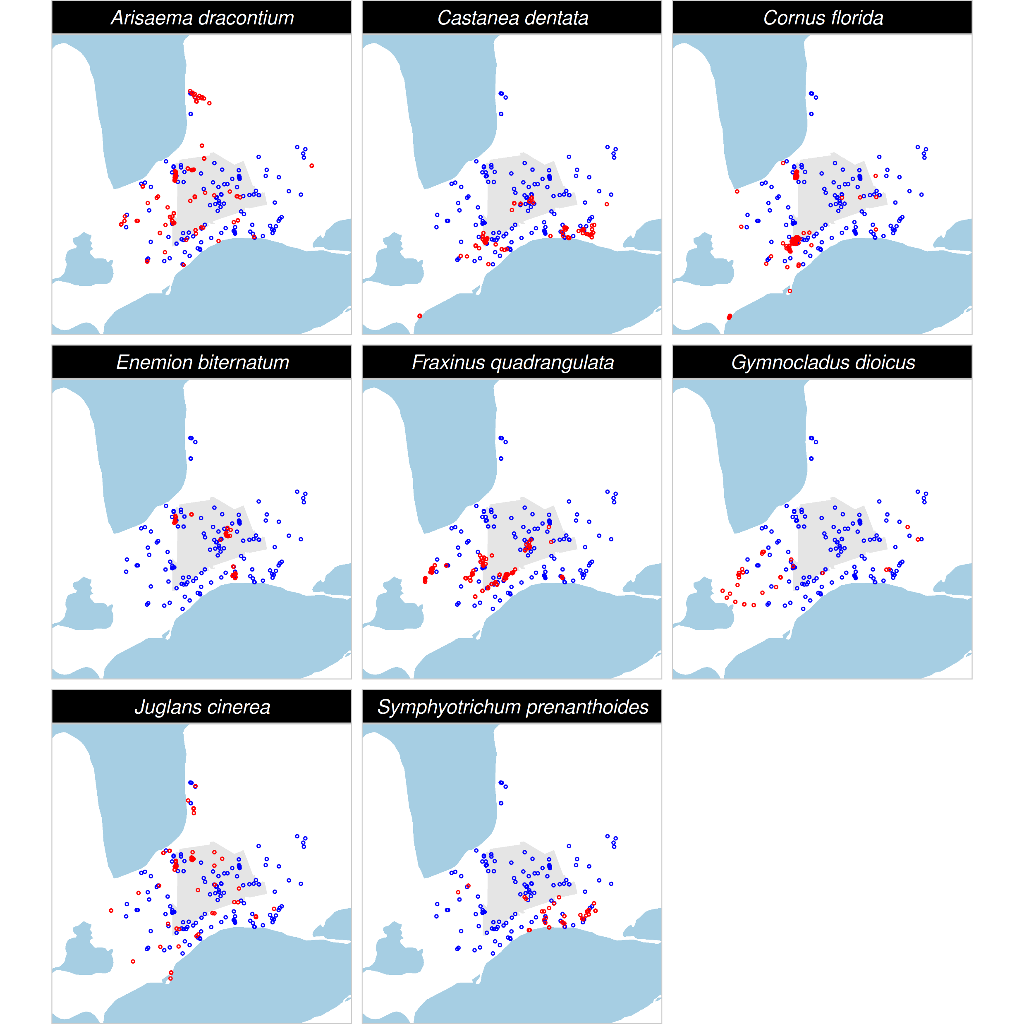
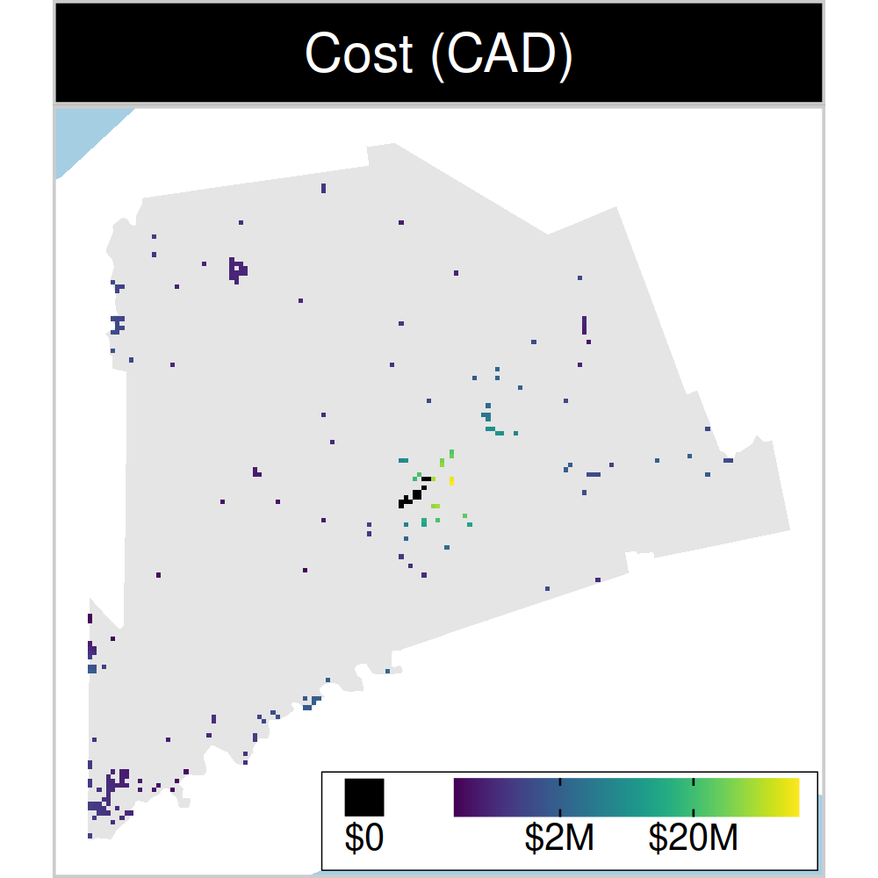
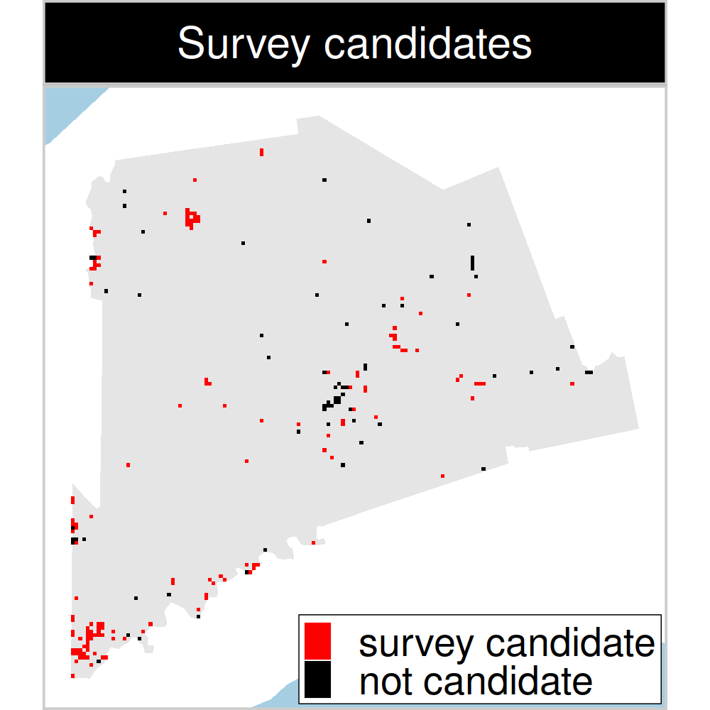
Study system: Middlesex county, Canada
199 places that could
potentially be acquired for
protected area establishment
143 places that could potentially be surveyed to
improve existing data
8 imperiled plant species
Hanson et al. 2022 J. Appl. Ecol
Notes:
41

Slide 42
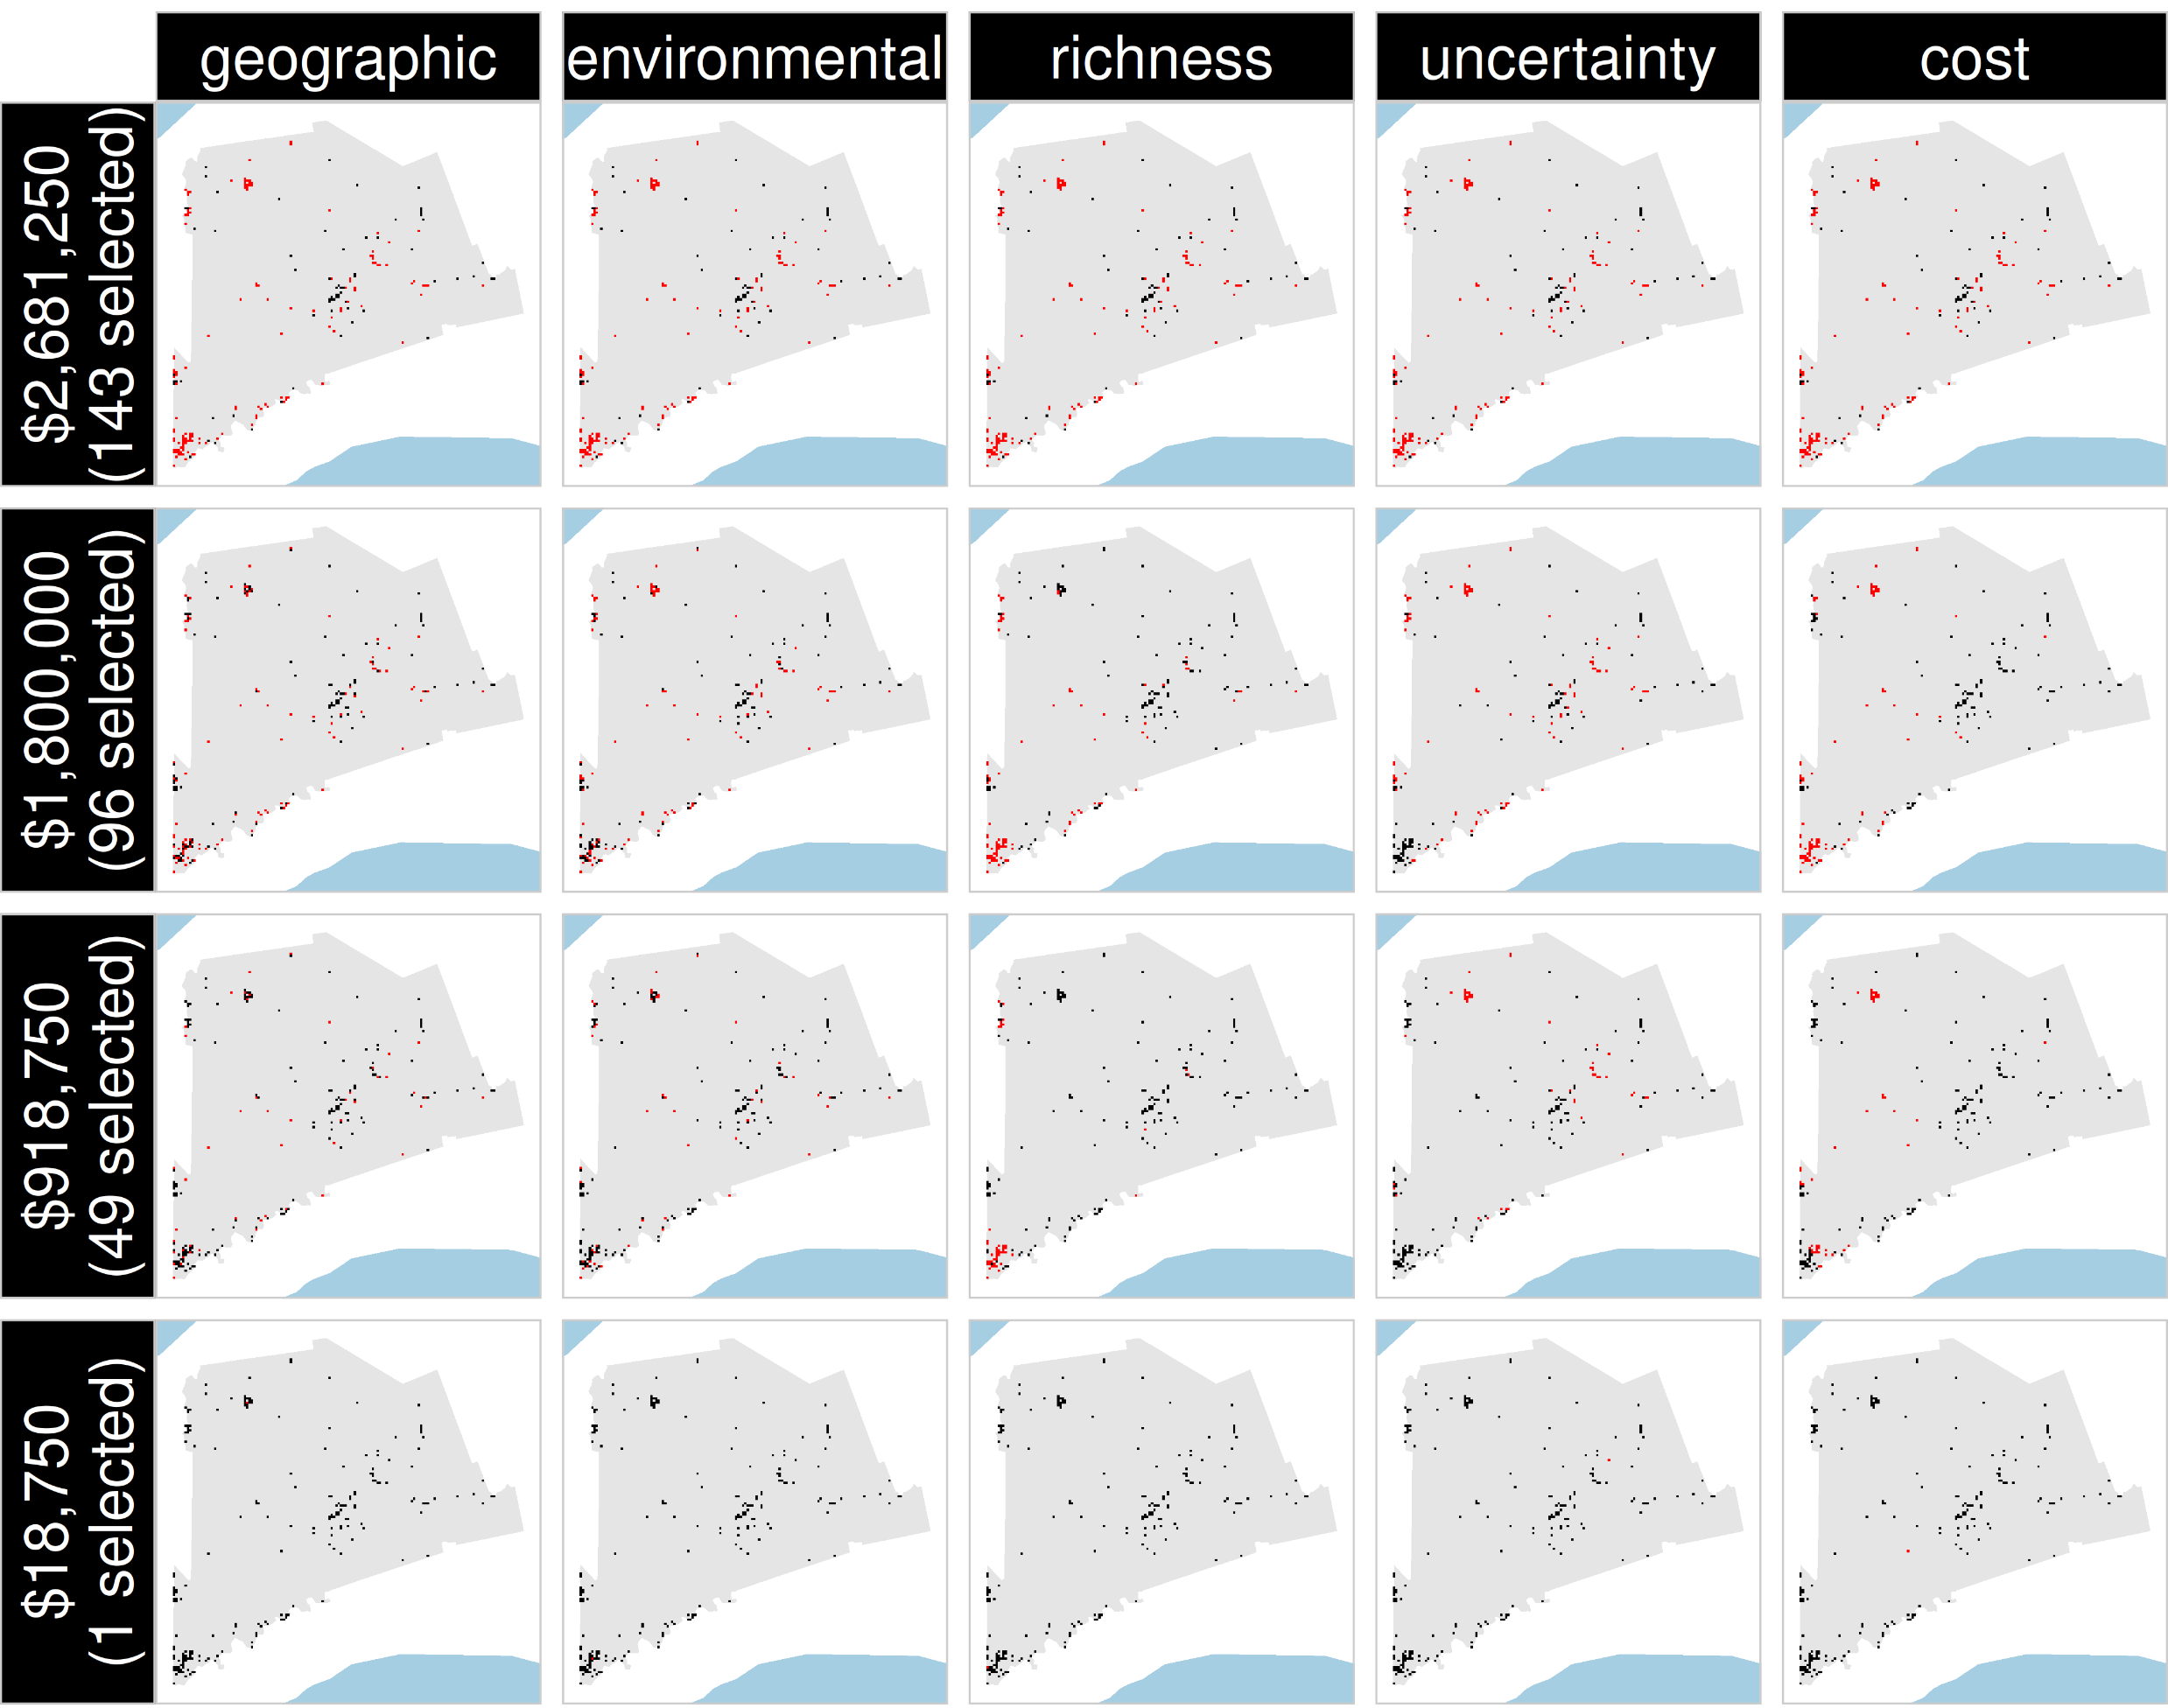
Selected
for survey
Number of places selected for surveys
(amount of funds allocated for collecting extra data)
NOT selected
for survey
Different approaches for designing survey schemes
Hanson et al. 2022 J. Appl. Ecol

Slide 43
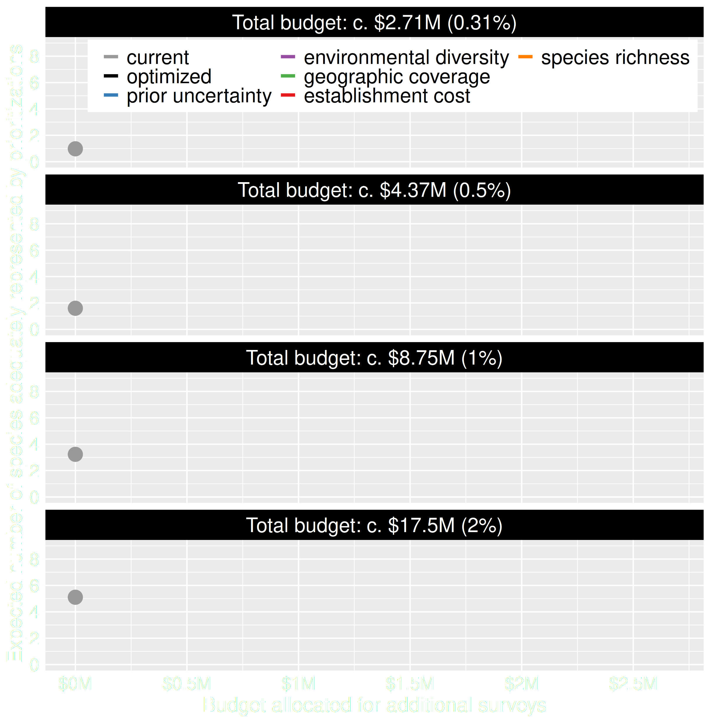
Value of information
Existing data leads to positive outcomes
More budget means better outcomes
Hanson et al. 2022 J. Appl. Ecol

Slide 44
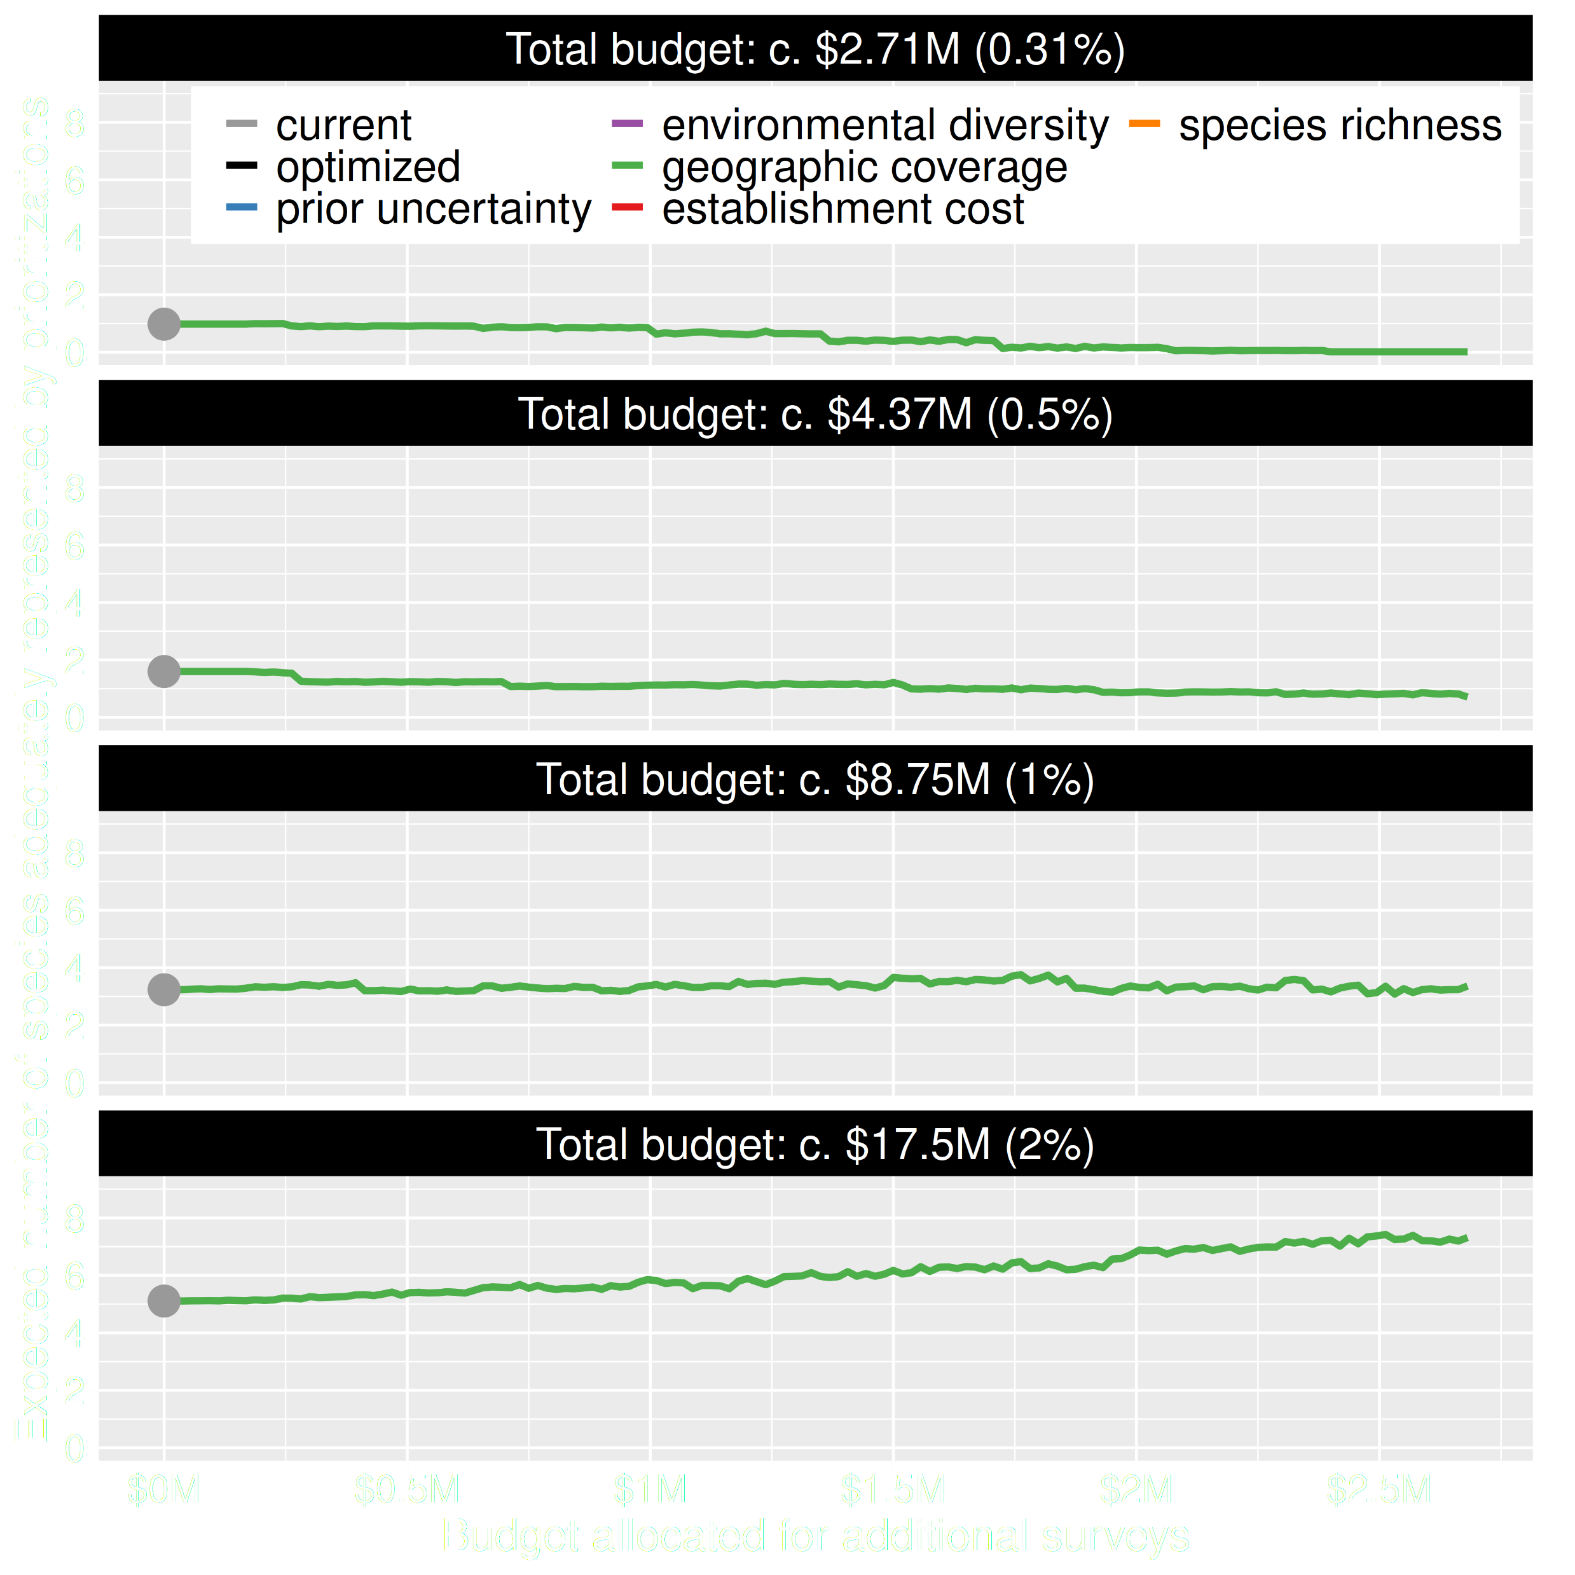
Value of information
Allocating funds for gathering more data can mean worse outcomes
Allocating funds for gathering more data can mean better outcomes too
Hanson et al. 2022 J. Appl. Ecol

Slide 45
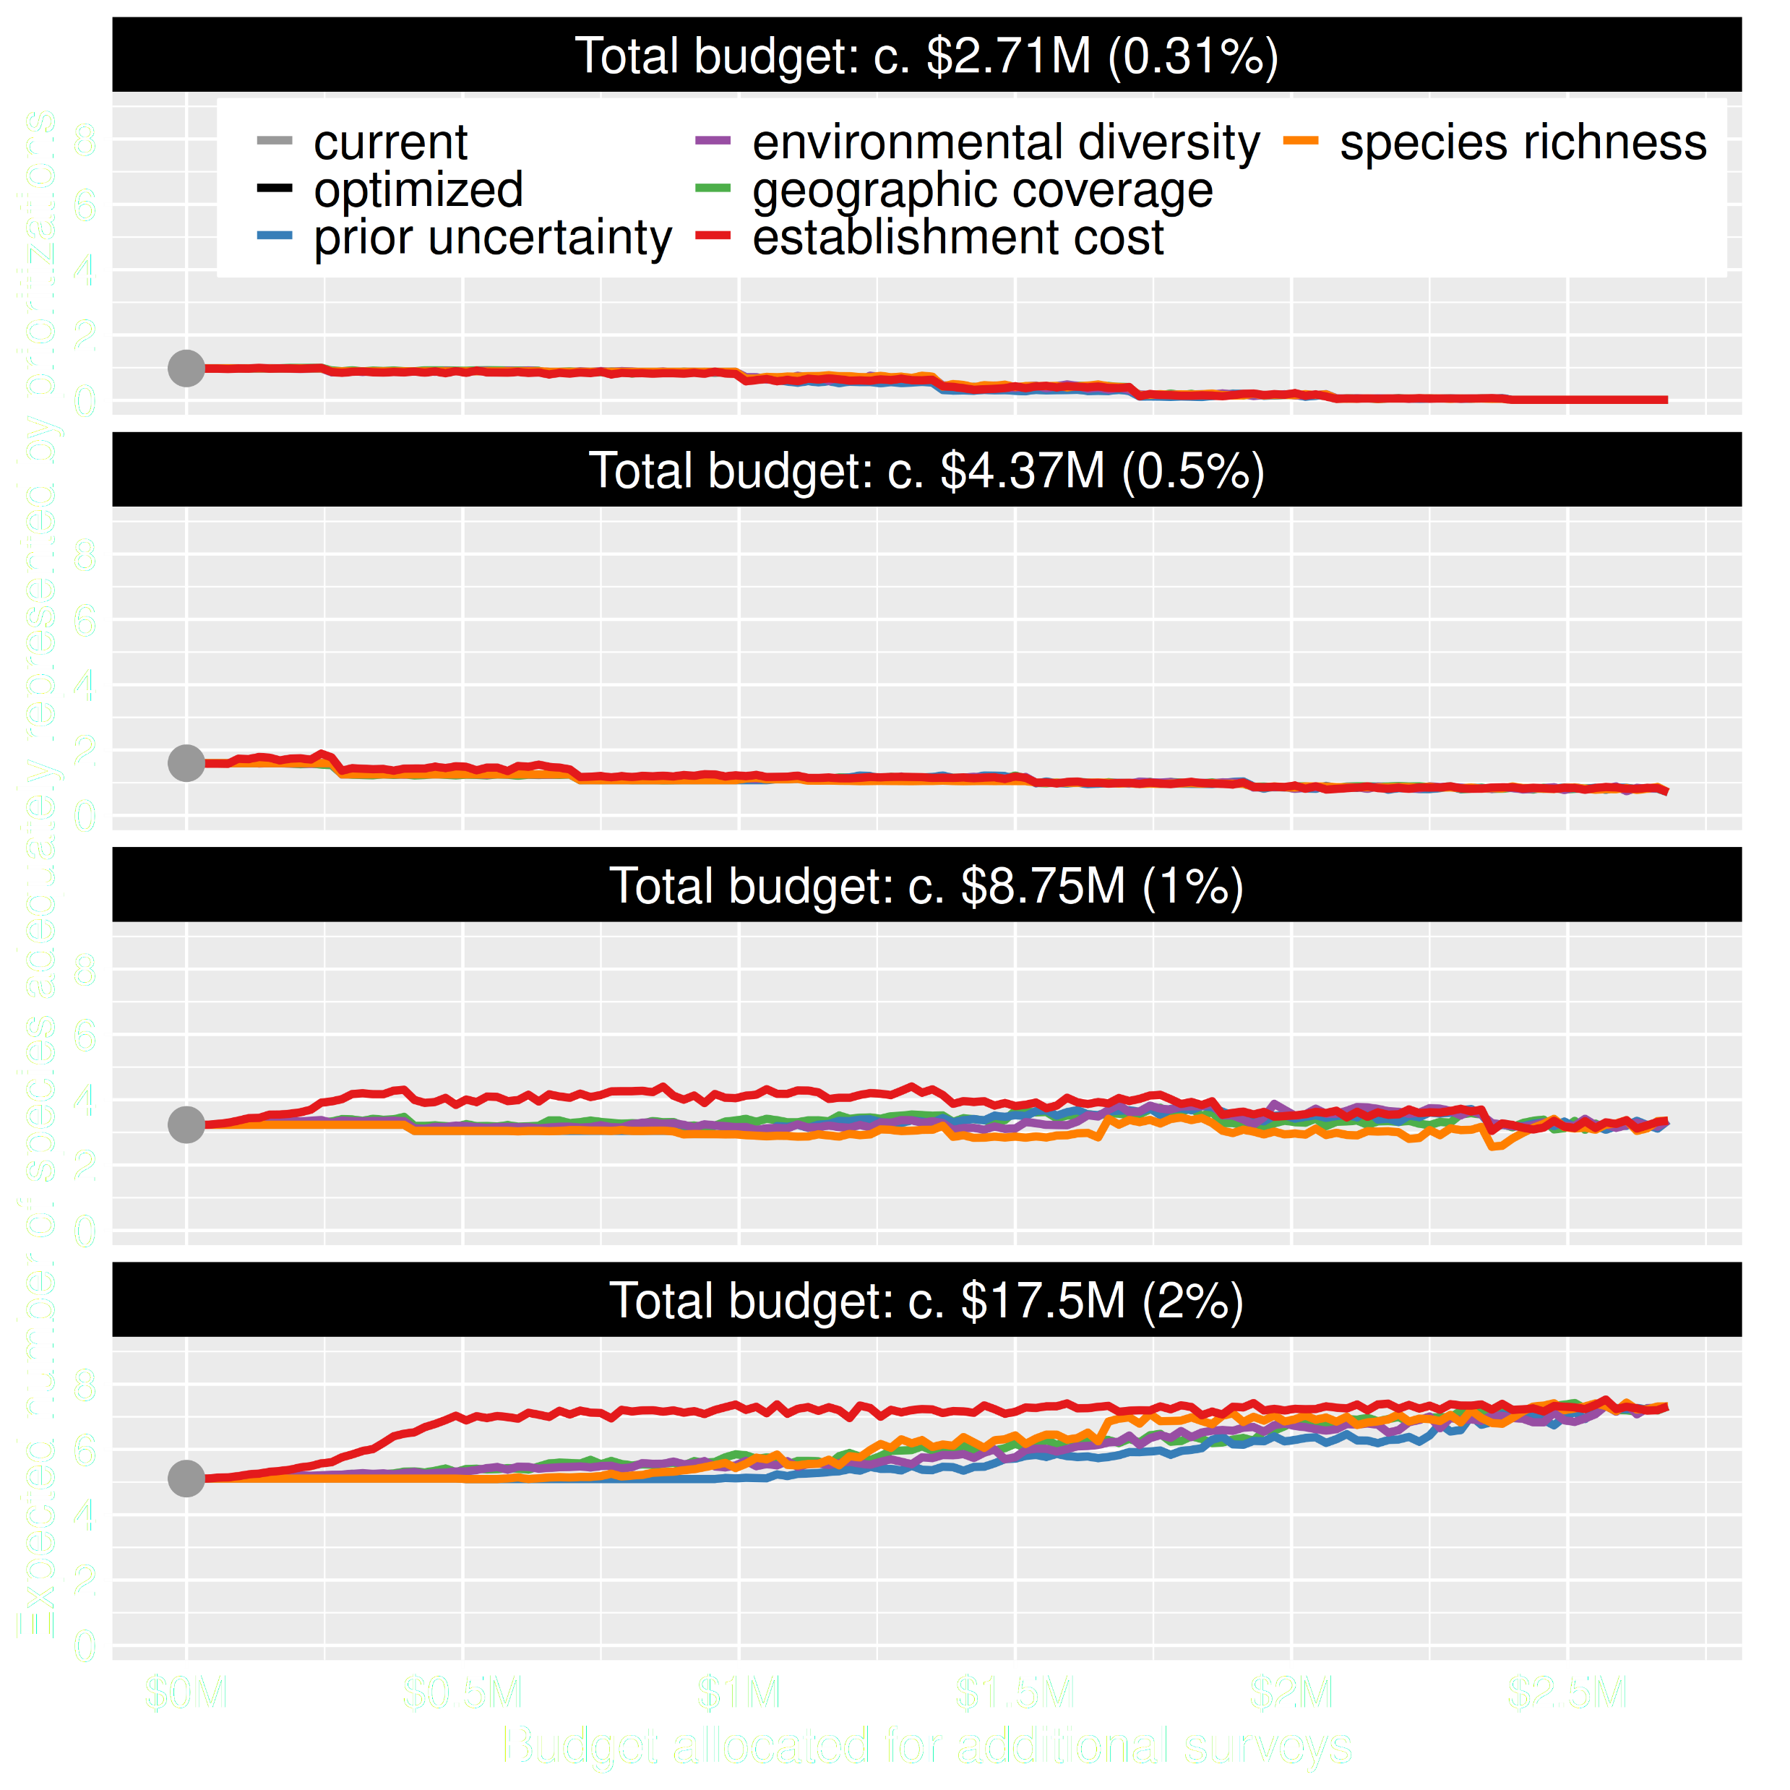
Value of information
Conventional approaches for gathering additional evidence have different performance
Performance of these approaches depends on available funds
All of them could lead to lead to worse outcomes
Hanson et al. 2022 J. Appl. Ecol

Slide 46
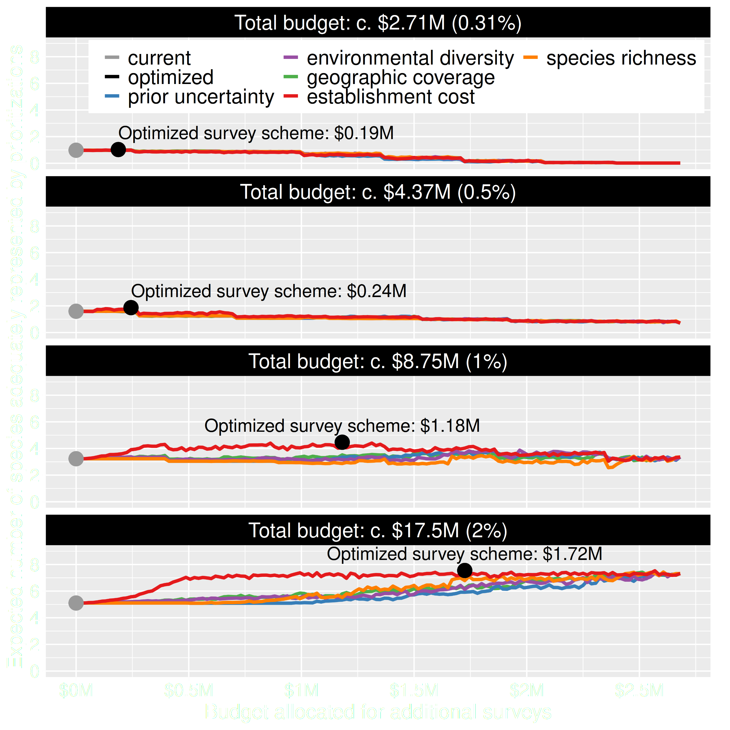
Value of information
Directly maximizing return on investment is best method for additional data
This considers objectives and constraints that underpin conservation plans and their success
Hanson et al. 2022 J. Appl. Ecol

Slide 47
How can we get a better conservation decision?
(1) Better algorithms
(2) Better data
(3) Better surrogates

Slide 48



Connectivity in reserve design
movement of individuals and genes between populations
*All else being equal

Slide 49
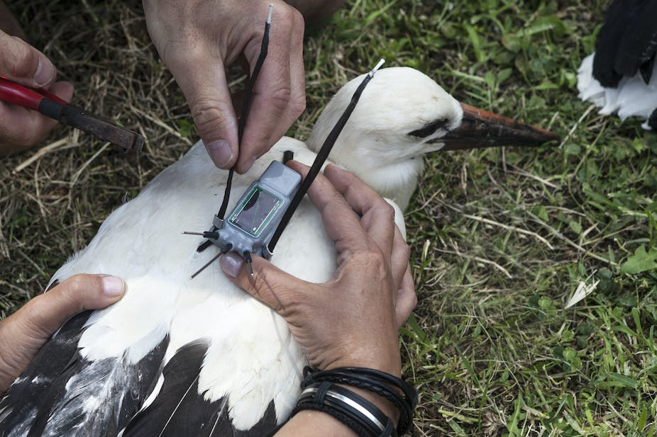

But getting connectivity data is hard
Animal telemetry
Molecular ecology

Slide 50
Rules of thumb for connectivity
More habitat = More connectivity
Total area protected
Species representation
Now
Soon
Later

Slide 51
Rules of thumb for connectivity
More spatial clustering = More connectivity
Boundary length

Slide 52

Rules of thumb for connectivity
Protect clusters of low resistance = More connectivity
Human pressure
Naturalness based landscape resistance
Focal species landscape resistance
Habitat heterogeneity
Environmental similarity
High resistance
Low resistance

Slide 53

A comparison of approaches for including connectivity in systematic conservation planning
Washington State, USA
261 bird species
Land acquisition costs
Existing protected areas
Multiple land-uses
Multiple eco-systems
Hanson et al. 2022 J. Appl. Ecol

Slide 54

Different connectivity approaches produce different prioritizations
Different connectivity approaches can yield similar prioritizations
Hanson et al. 2022 J. Appl. Ecol

Slide 55

How do the prioritizations compare?
Approach
Habitat-based
Spatial
clustering
Resistance-based
Hanson et al. 2022 J. Appl. Ecol

Slide 56

No obvious winner
Hanson et al. 2022 J. Appl. Ecol

